Slide 1
Thermo-Hydraulics (THM) MOOSE Module Utah Forge Simulation Version 2
Intern: Benjamin Willis
Mentor: Robert Podgorney

Slide 2
Base 1 Fracture Model
(0,0,0)
(1,0,0)
I.D = 0.18 m
(1,0,-1957)
(0,0,-2057)
(1122.4,0,-2531.9)
I.D = 0.5 m, 1 m, or 2 m
(1122.6,0,-2632.1)

Slide 3
3 Fracture Model with perforations for fractures 1 and 2 and open hole for fracture 3
inlet
outlet
production_pipe
injection_pipe
fracture1_perf2
jct8
jct_fracture1_perf2
pipe7
jct7
jct6
pipe6
jct5
pipe5
jct1
fracture1
pipe2
fracture2
fracture3
jct_fracture1_perf1
pipe3
jct2
pipe4
fracture1_perf1
jct3
jct4

Slide 4
Model Pipe Lengths (all approximated)
fracture1 injection well distance ~= 3087 m ~= 10130 ft
fracture2 injection well distance ~= 3221 m ~= 10570 ft
fracture3 injection well distance ~= 3317 m ~= 10887 ft
1957 m
2057 m
1 m
98 m
1 m
100 m
1030 m
134 m
96 m

Slide 5
Post-processor locations
m_dot_inlet,
injection_pressure
m_dot_outlet, production_pressure
pressure_drop = abs(injection_pressure – production_pressure)
T_fracture1_outlet, pressure_out_fracture1
T_fracture2_outlet , pressure_out_fracture2
T_fracture3_outlet , pressure_out_fracture3
m_dot_fracture1_inlet,
T_fracture1_inlet , pressure_in_fracture1
pressure_drop_fracture# = abs(pressure_in_fracture#– pressure_in_fracture#)
m_dot_fracture2_inlet,
T_fracture2_inlet , pressure_in_fracture2
m_dot_fracture3_inlet,
T_fracture3_inlet , pressure_in_fracture3

Slide 6
2 Fracture Model with perforations for fractures 1 and 2
inlet
outlet
production_pipe
injection_pipe
fracture1_perf2
jct8
jct_fracture1_perf2
pipe7
jct7
jct6
pipe6
jct1
fracture1
pipe2
fracture2
jct_fracture1_perf1
pipe3
jct2
fracture1_perf1
jct3

Slide 7
Model Pipe Lengths (all approximated)
fracture1 injection well distance ~= 3087 m ~= 10130 ft
fracture2 injection well distance ~= 3221 m ~= 10570 ft
1957 m
2057 m
1 m
98 m
100 m
1 m
1030 m
134 m

Slide 8
Post-processor locations
m_dot_inlet,
injection_pressure
m_dot_outlet, production_pressure
pressure_drop = abs(injection_pressure – production_pressure)
T_fracture1_outlet, pressure_out_fracture1
T_fracture2_outlet , pressure_out_fracture2
m_dot_fracture1_inlet,
T_fracture1_inlet , pressure_in_fracture1
pressure_drop_fracture# = abs(pressure_in_fracture#– pressure_in_fracture#)
m_dot_fracture2_inlet,
T_fracture2_inlet , pressure_in_fracture2

Slide 9
Sensitivity Studies Performed
3 fracture zones (with Open Hole at Toe) vs. 2 fracture zones (no Open Hole at Toe)
0.5 m vs. 1 m vs. 2 m fracture diameter
2 kg/s vs. 5 kg/s vs. 10 kg/s
Exit Perforations turned off and both perforations turned off

Slide 10
Parameters
Component Name | Parameters Used
inlet | m_dot = 2, 5, or 10 kg/s T_in = 25°C
outlet | p = 2 MPa (~= 145 PSI)
Perforations | Diameter = 0.009525 m, 10 perfs assumed → Diameter = 0.09525 m Length = 1 m
Fractures | Diameter = 0.5 m, 1 m, or 2 m Length = 98 m
All pipes | # of elements = 200 custom_closures used (f = 0.0167, Hw = 2000)
Temperature with Elevation | Linear interpolation between 25°C at z = 0 m 196°C at z = -2800 m
Pressure with Elevation | Linear interpolation between 101.325 kPa at z = 0 m 25.1865e3 kPa at z = -2800 m

Slide 11
Fluid Properties Used
Modules/FluidProperties Name | Parameters Used
water | type = StiffenedGasFluidProperties gamma = 2.35 (heat capacity ratio) cv = 1816 (Constant volume specific heat) q = -1.167e6 (defines zero point of internal energy) p_inf = 1e9 (stiffness parameter) mu = 1e-4 Pa*s (Dynamic viscosity) q_prime = 0 (Default)

Slide 12
Heat Structure Materials
HeatStructureMaterials Name | Parameters Used
mild_steel (used for pipe wall) | rho = 7850 kg/m³ cp = 510.8 J/(kg*K) k = 60 W/(m*K)
cement | rho = 2400 kg/m³ cp = 920 J/(kg*K) k = 0.29 W/(m*K)
rock | rho = 2750 kg/m³ cp = 830 J/(kg*K) k = 3 W/(m*K)

Slide 13
Preconditioning Used
Preconditioner Name | Parameters Used
pc | type = SMP full = true

Slide 14
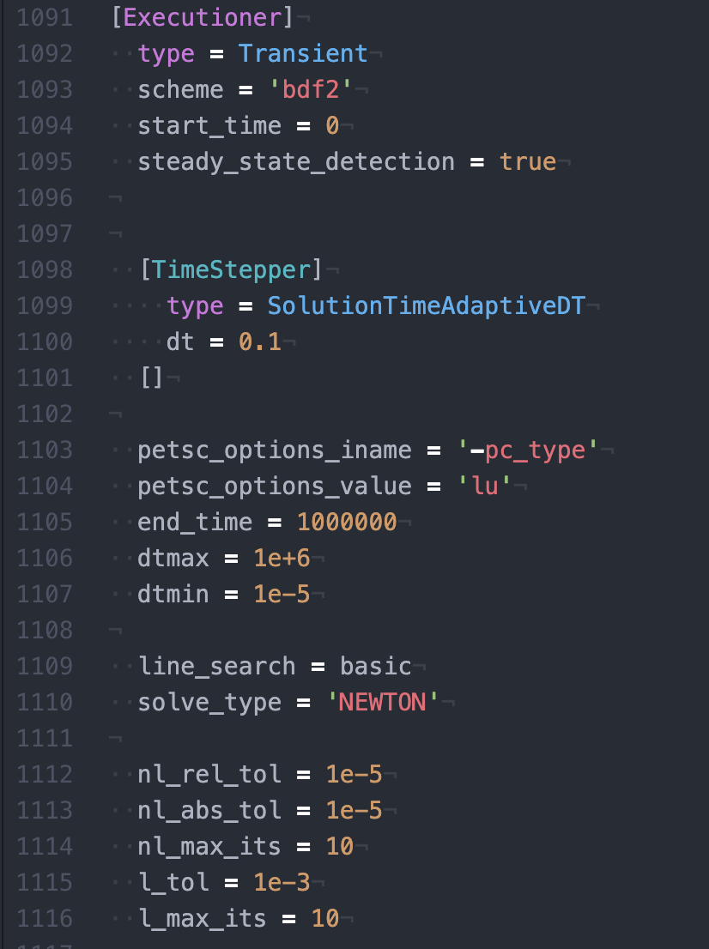
Executioner Used

Slide 15
Heat Structures for pipes
INNER_RADIUS = 0.09 m = pipe radius
R = 50 m
Temperature BCs: based on Temperature with Elevation
pipe
pipe wall
cement
rock
Width pipe wall = 0.00635 m
Width cement = 0.0051 m
Width rock = 49.95 m

Slide 16
Heat Structures for fractures
INNER_RADIUS = 0.5 m or 1 m = fracture radius
R = 50 m
Temperature BCs: based on Temperature with Elevation
fracture (treated as a pipe)
rock
Width rock = 50 m

Slide 17
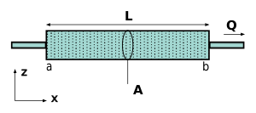
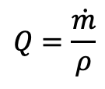
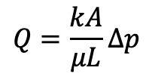
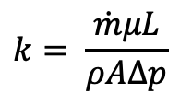
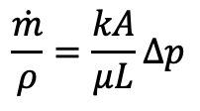
Calculating Fracture Permeability Using Darcy’s Law
$$Q=\frac{kA}{μL}∆p$$
Equation 1
$$Q=\frac{\dot{m}}{ρ}$$
Equation 2
$$\frac{\dot{m}}{ρ}=\frac{kA}{μL}∆p$$
Equations 1 and 2
$$k= \frac{\dot{m}μL}{ρA∆p}$$
Solve for k
Use $μ,$ $ρ$, and $\dot{m}$ at inlet and outlet of fracture and compare value

Slide 18
3 Fracture Zones Study
With Open Hole for Fracture 3 (Toe)

Slide 19
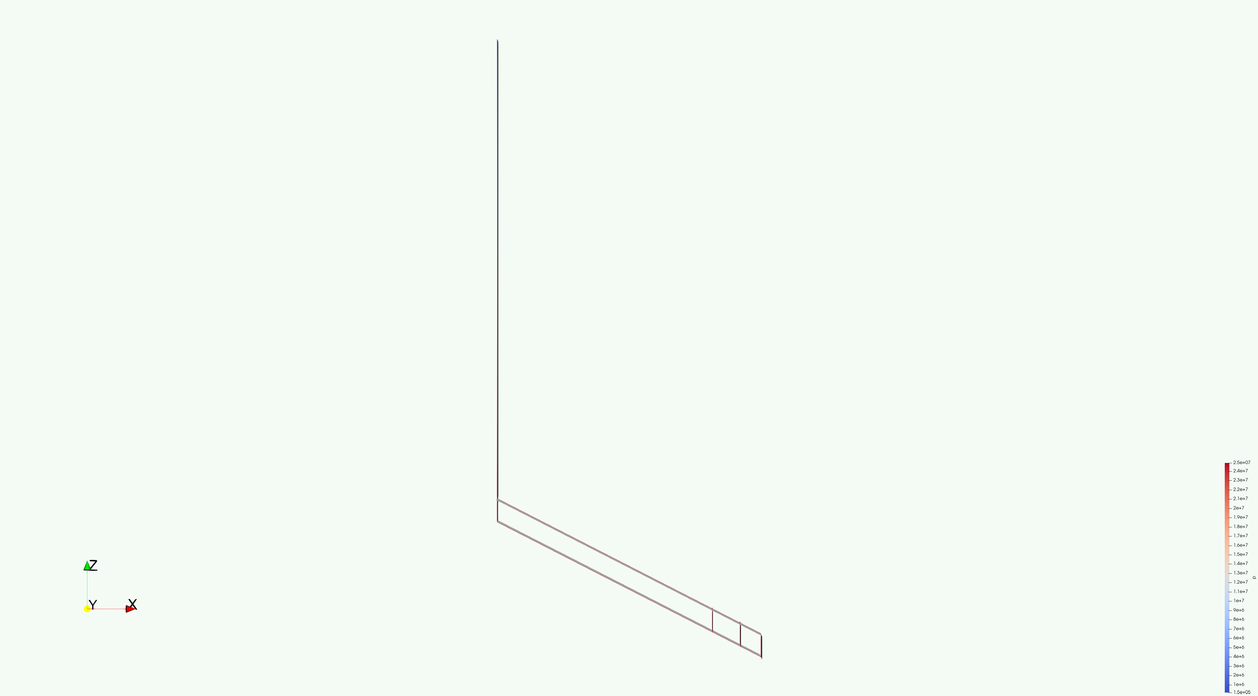
Paraview at ~= 1,000,000s, 3 fracture zones

Slide 20
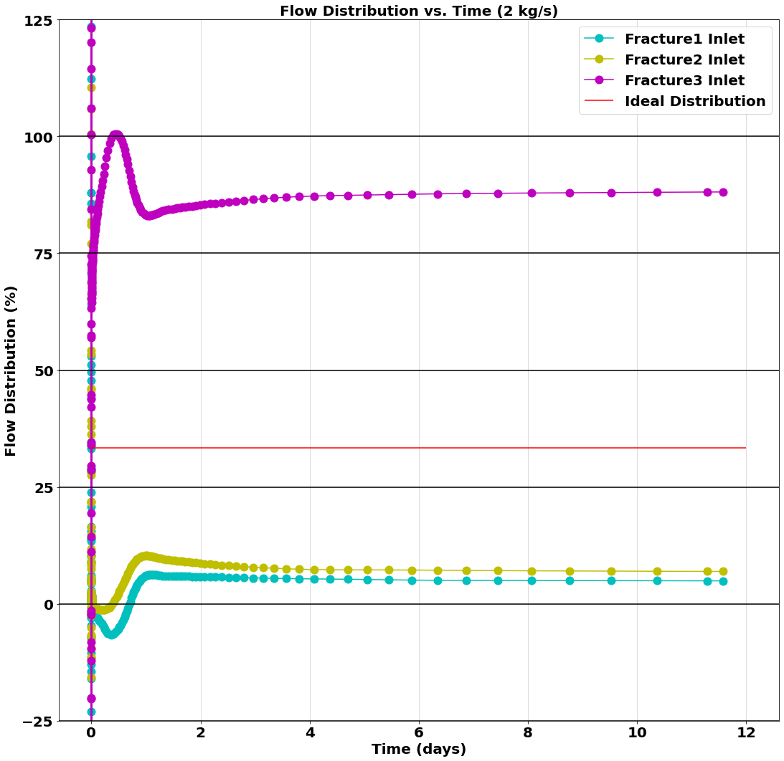
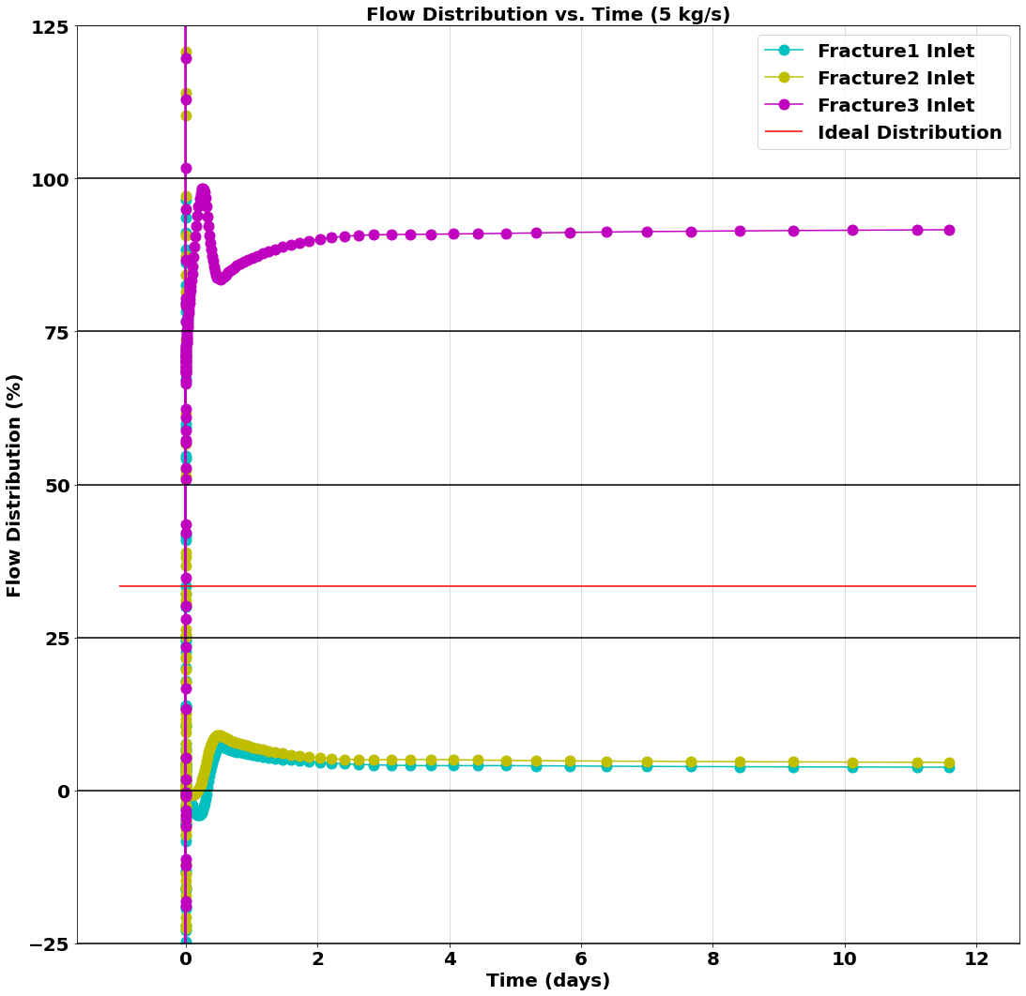
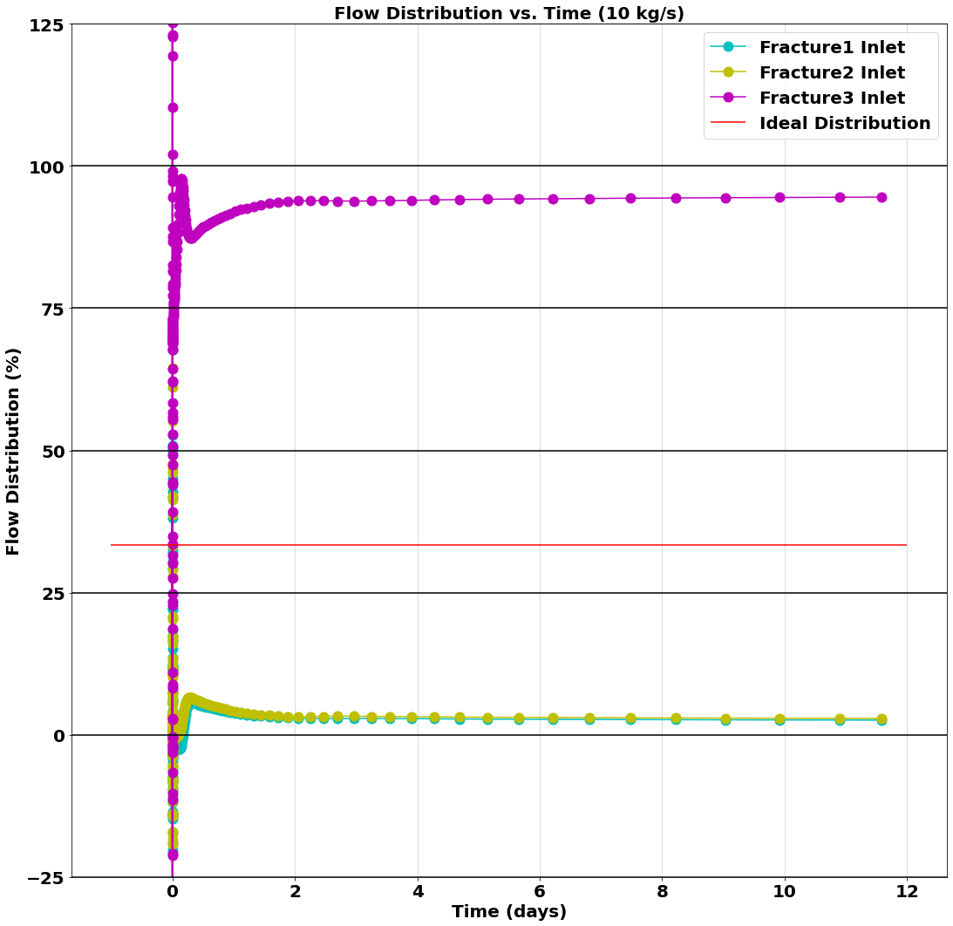
Flow Distribution Percentage (Fracture Diameter = 0.5 m)
Input file: 2kgs_0.5m.i
Output files: 2kgs_0.5m_CSV.csv
2kgs_0.5m_exodus.e
GitHub Repository Link
Input file: 5kgs_0.5m.i
Output files: 5kgs_0.5m_CSV.csv
5kgs_0.5m_exodus.e
GitHub Repository Link
Input file: 10kgs_0.5m.i
Output files: 10kgs_0.5m_CSV.csv
10kgs_0.5m_exodus.e
GitHub Repository Link

Slide 21
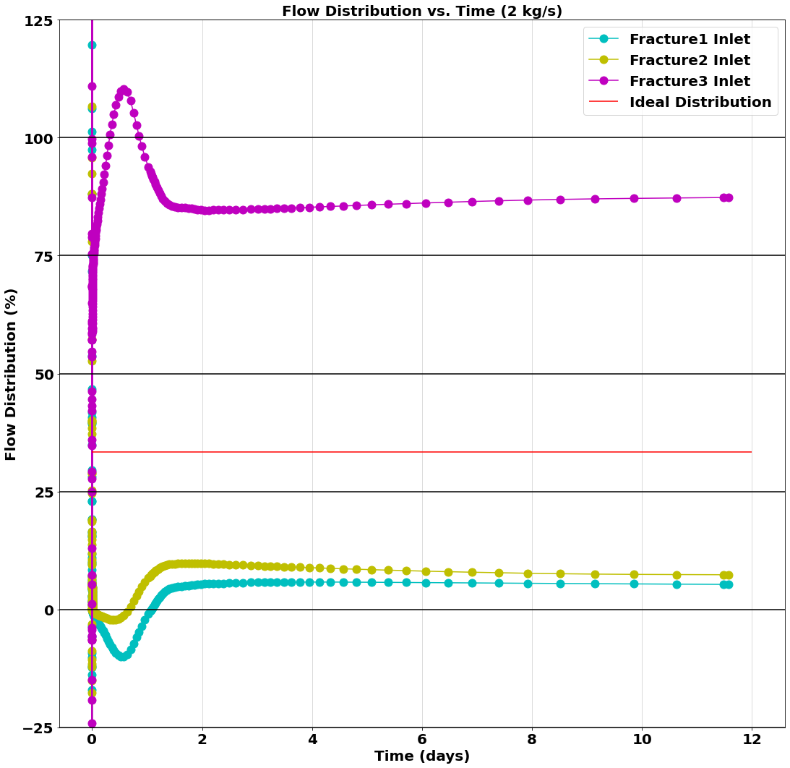
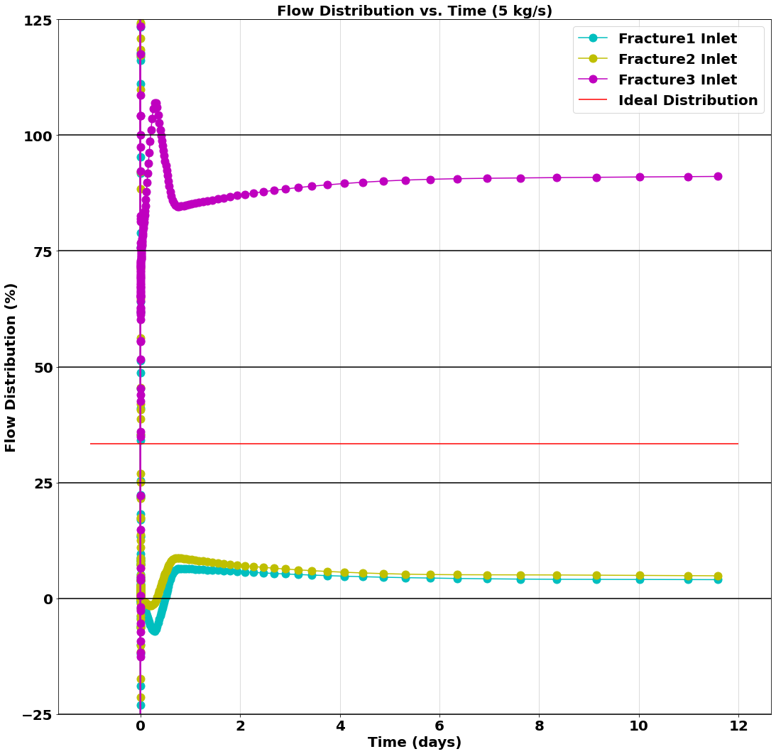
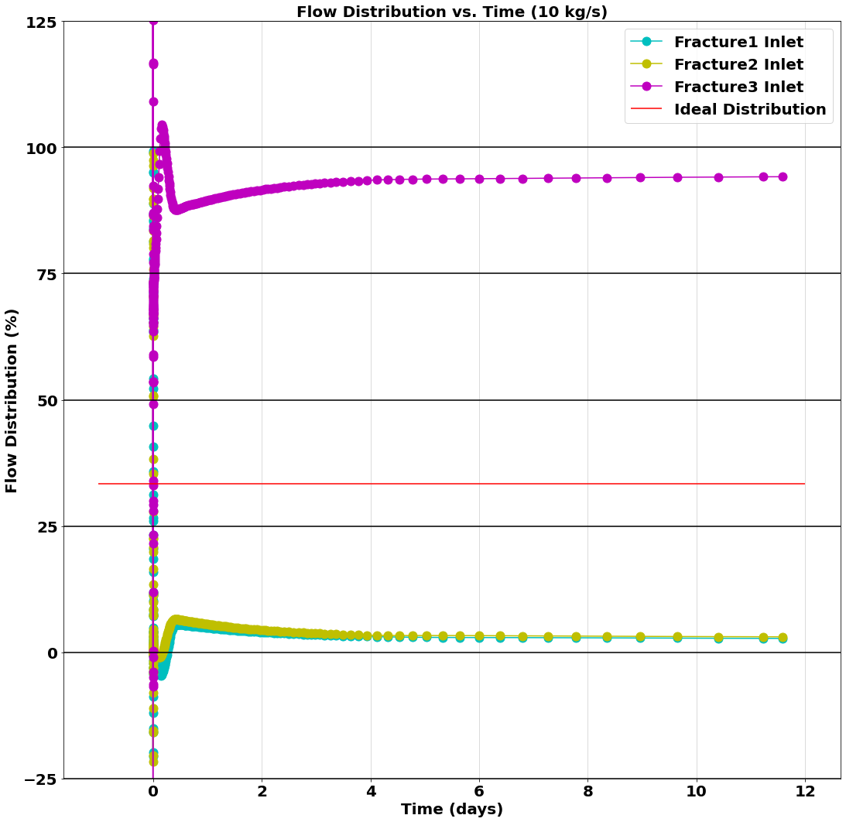
Flow Distribution Percentage (Fracture Diameter = 1 m)
Input file: 2kgs_1m.i
Output files: 2kgs_1m_CSV.csv
2kgs_1m_exodus.e
GitHub Repository Link
Input file: 5kgs_1m.i
Output files: 5kgs_1m_CSV.csv
5kgs_1m_exodus.e
GitHub Repository Link
Input file: 10kgs_1m.i
Output files: 10kgs_1m_CSV.csv
10kgs_1m_exodus.e
GitHub Repository Link

Slide 22
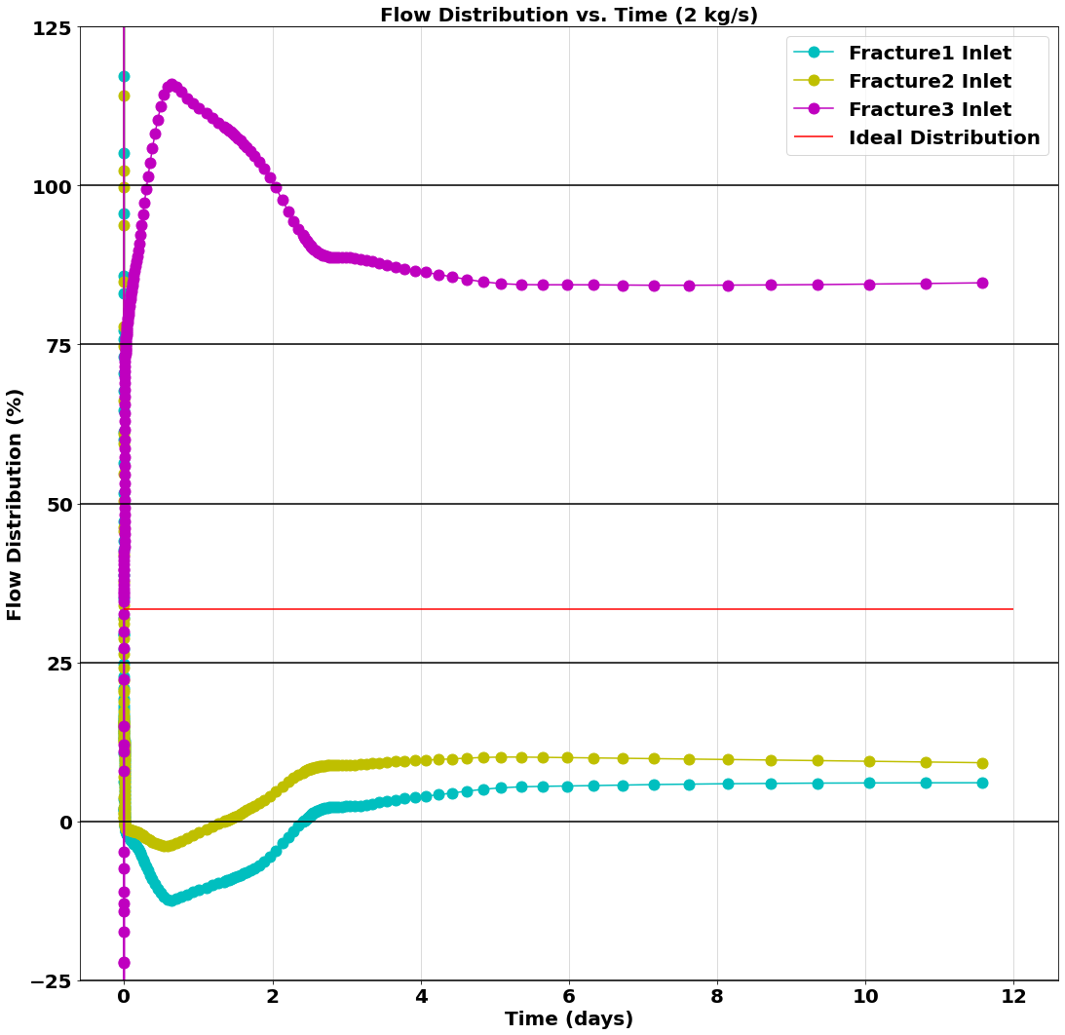
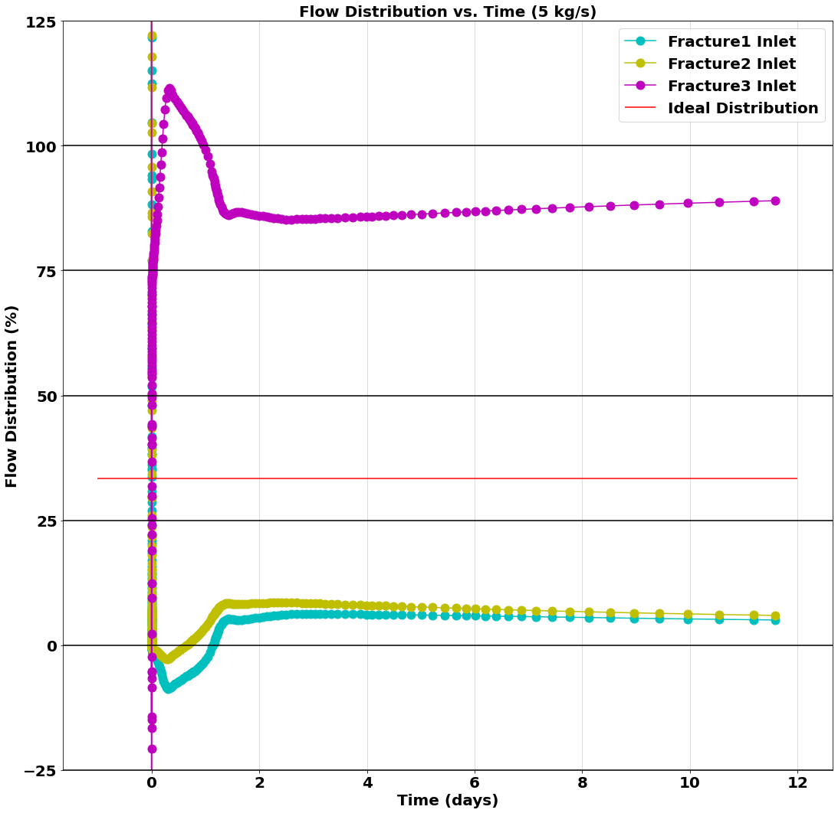
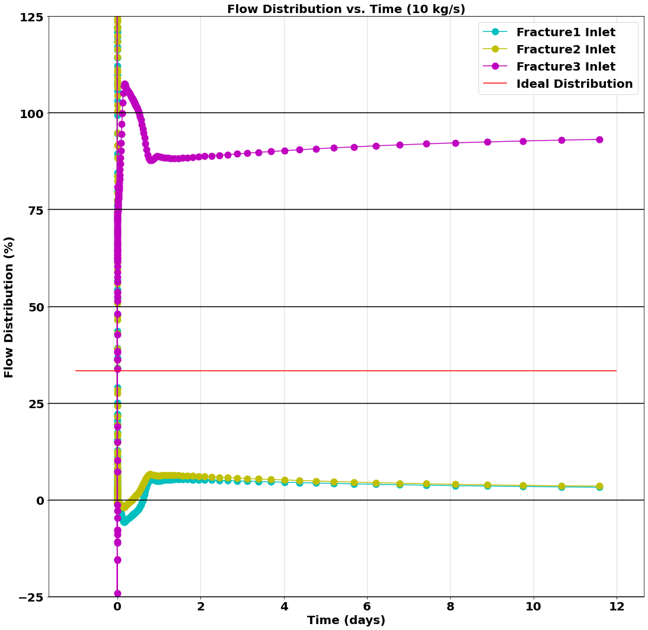
Flow Distribution Percentage (Fracture Diameter = 2 m)
Input file: 2kgs_2m.i
Output files: 2kgs_2m_CSV.csv
2kgs_2m_exodus.e
GitHub Repository Link
Input file: 5kgs_2m.i
Output files: 5kgs_2m_CSV.csv
5kgs_2m_exodus.e
GitHub Repository Link
Input file: 10kgs_2m.i
Output files: 10kgs_2m_CSV.csv
10kgs_2m_exodus.e
GitHub Repository Link

Slide 23
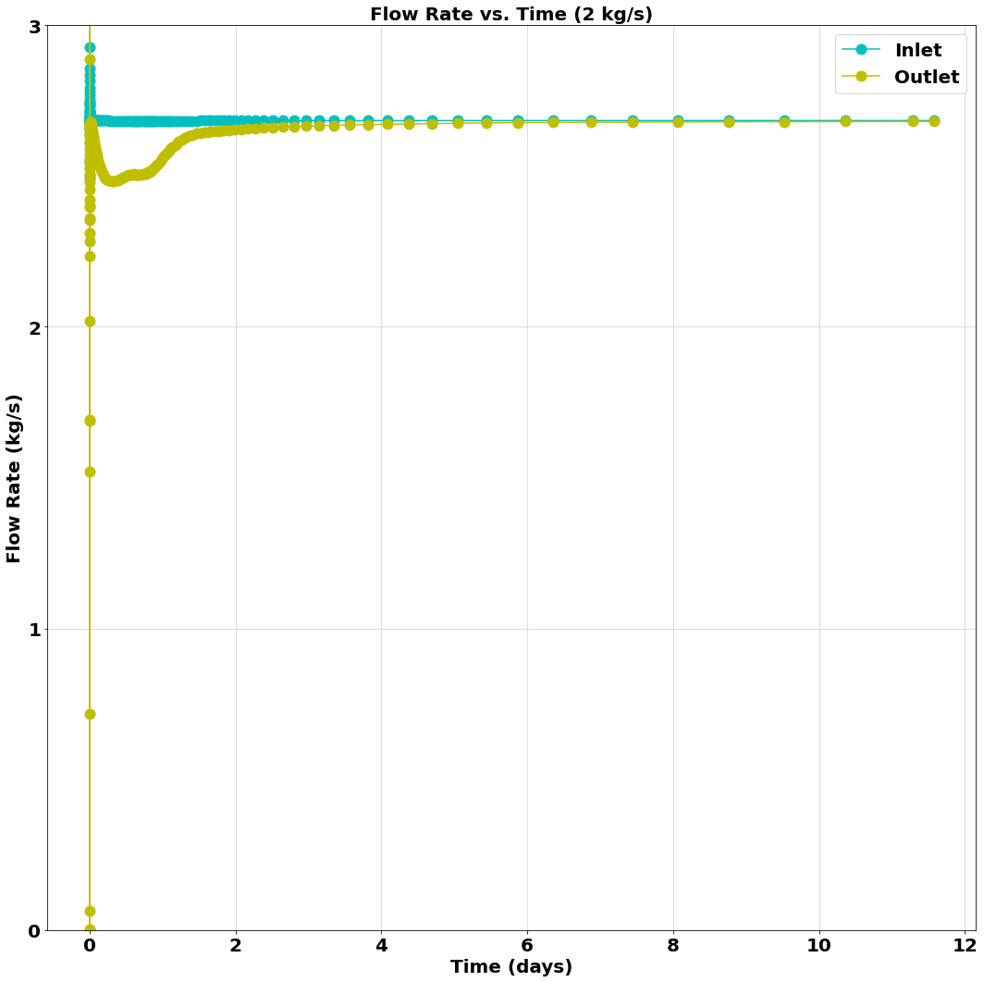
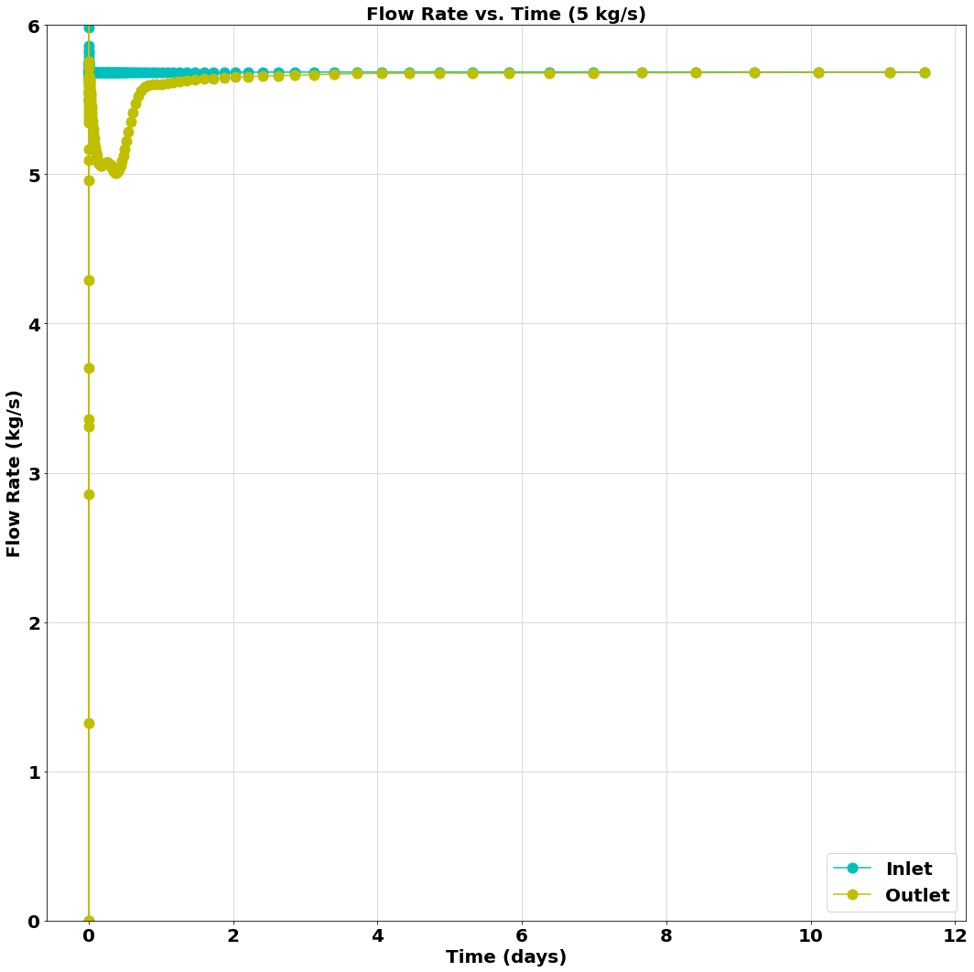
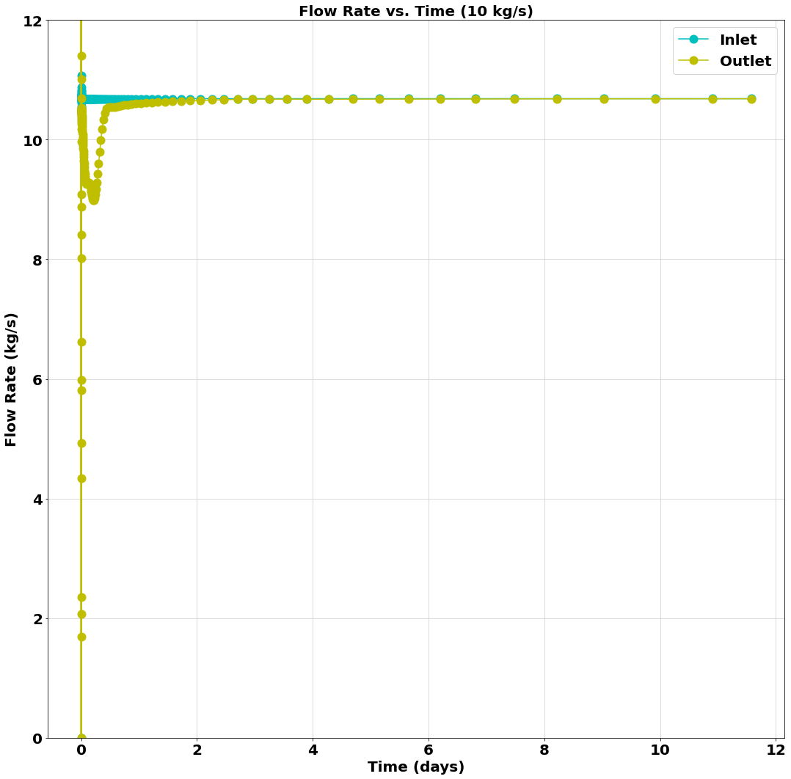
Flowrate Inlet and Outlet
(Fracture Diameter = 0.5 m)
Input file: 2kgs_0.5m.i
Output files: 2kgs_0.5m_CSV.csv
2kgs_0.5m_exodus.e
GitHub Repository Link
Input file: 5kgs_0.5m.i
Output files: 5kgs_0.5m_CSV.csv
5kgs_0.5m_exodus.e
GitHub Repository Link
Input file: 10kgs_0.5m.i
Output files: 10kgs_0.5m_CSV.csv
10kgs_0.5m_exodus.e
GitHub Repository Link

Slide 24
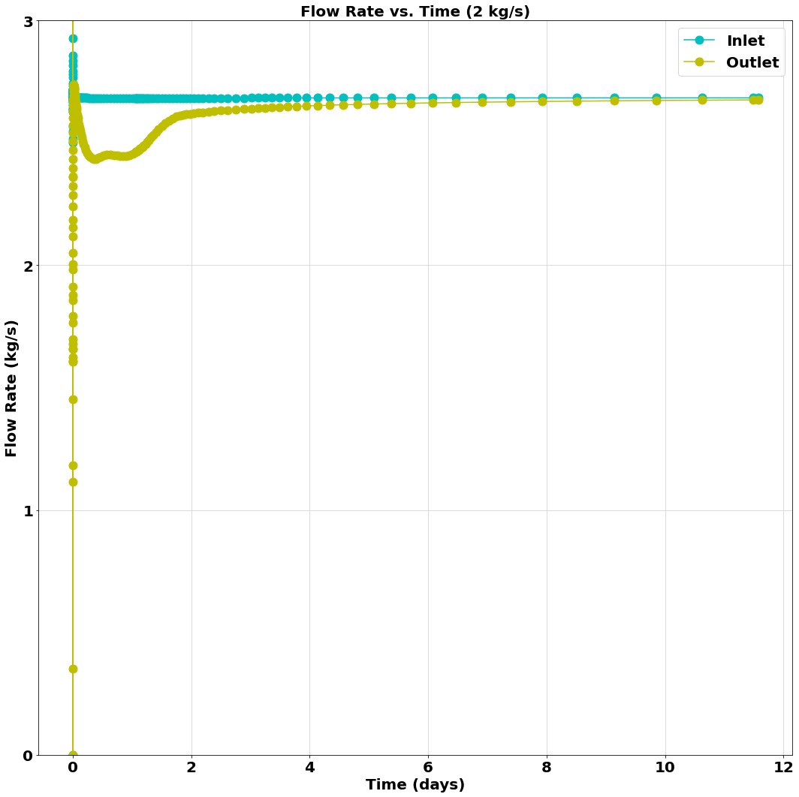
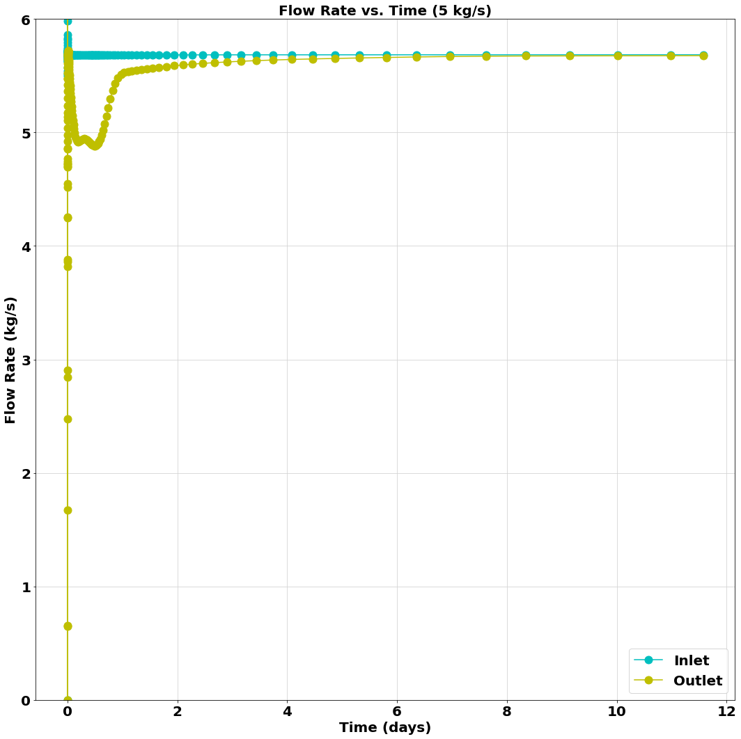
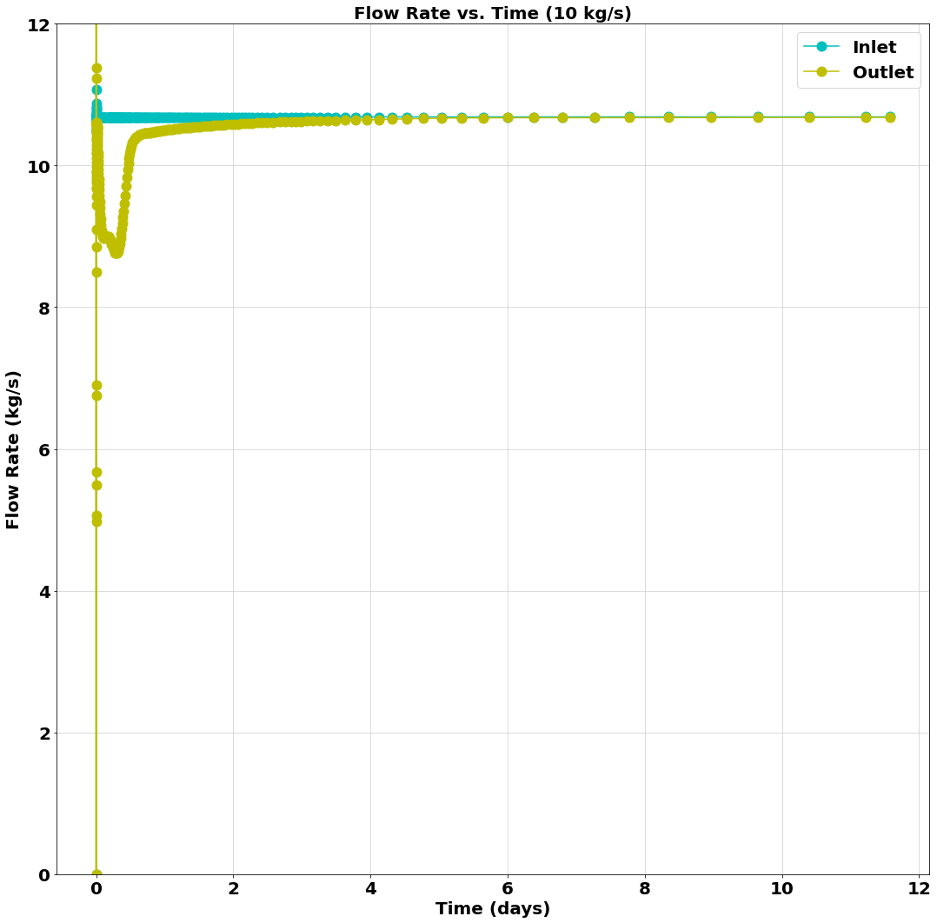
Flowrate Inlet and Outlet
(Fracture Diameter = 1 m)
Input file: 2kgs_1m.i
Output files: 2kgs_1m_CSV.csv
2kgs_1m_exodus.e
GitHub Repository Link
Input file: 5kgs_1m.i
Output files: 5kgs_1m_CSV.csv
5kgs_1m_exodus.e
GitHub Repository Link
Input file: 10kgs_1m.i
Output files: 10kgs_1m_CSV.csv
10kgs_1m_exodus.e
GitHub Repository Link

Slide 25
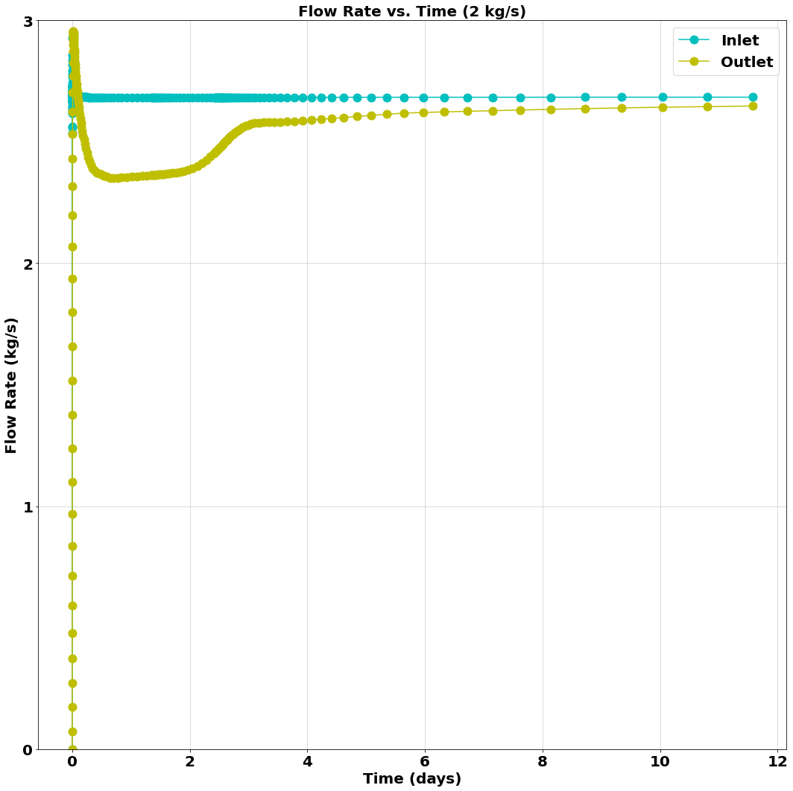
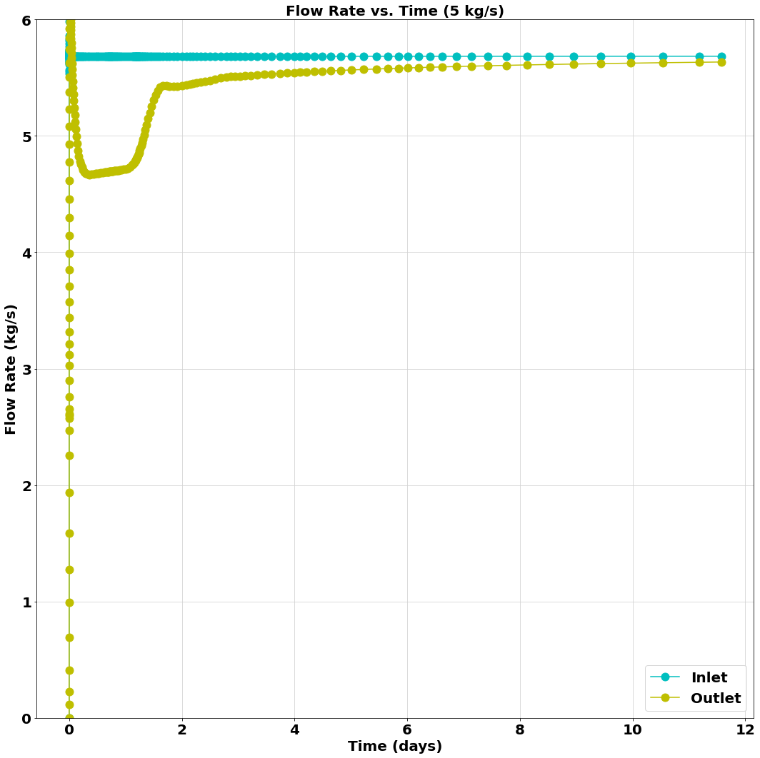
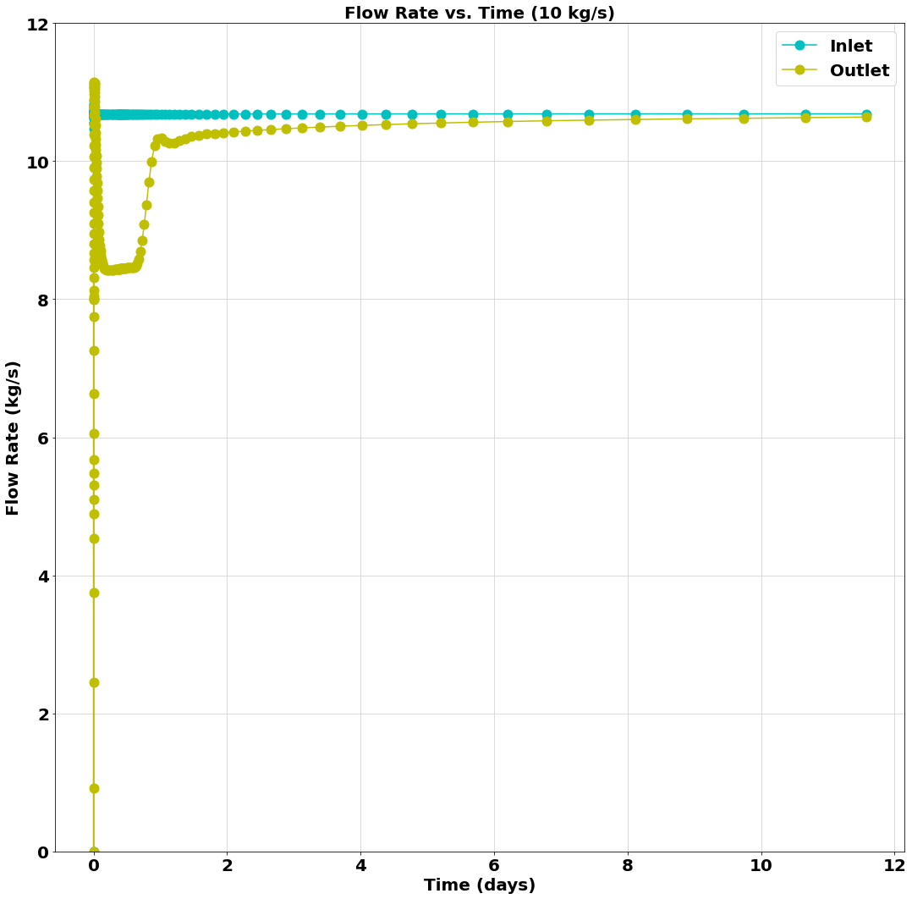
Flowrate Inlet and Outlet
(Fracture Diameter = 2 m)
Input file: 2kgs_2m.i
Output files: 2kgs_2m_CSV.csv
2kgs_2m_exodus.e
GitHub Repository Link
Input file: 5kgs_2m.i
Output files: 5kgs_2m_CSV.csv
5kgs_2m_exodus.e
GitHub Repository Link
Input file: 10kgs_2m.i
Output files: 10kgs_2m_CSV.csv
10kgs_2m_exodus.e
GitHub Repository Link

Slide 26
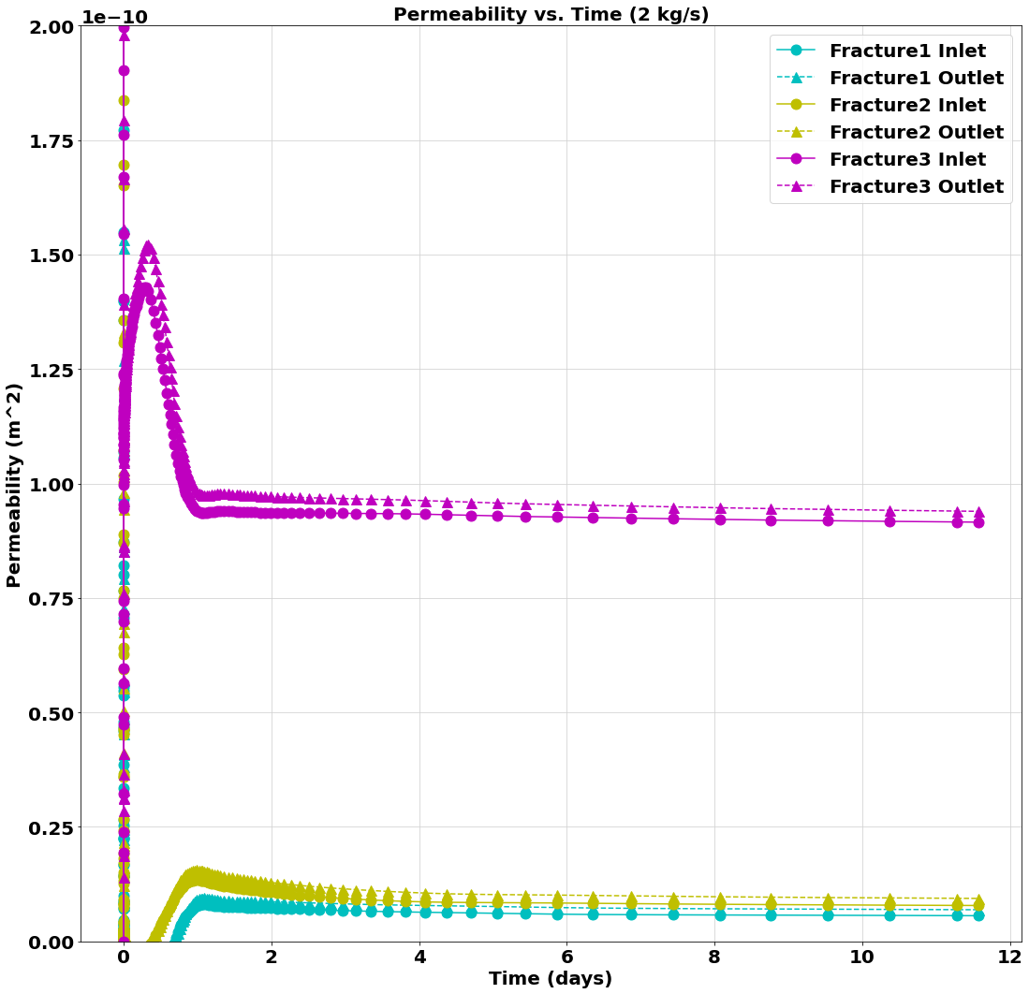
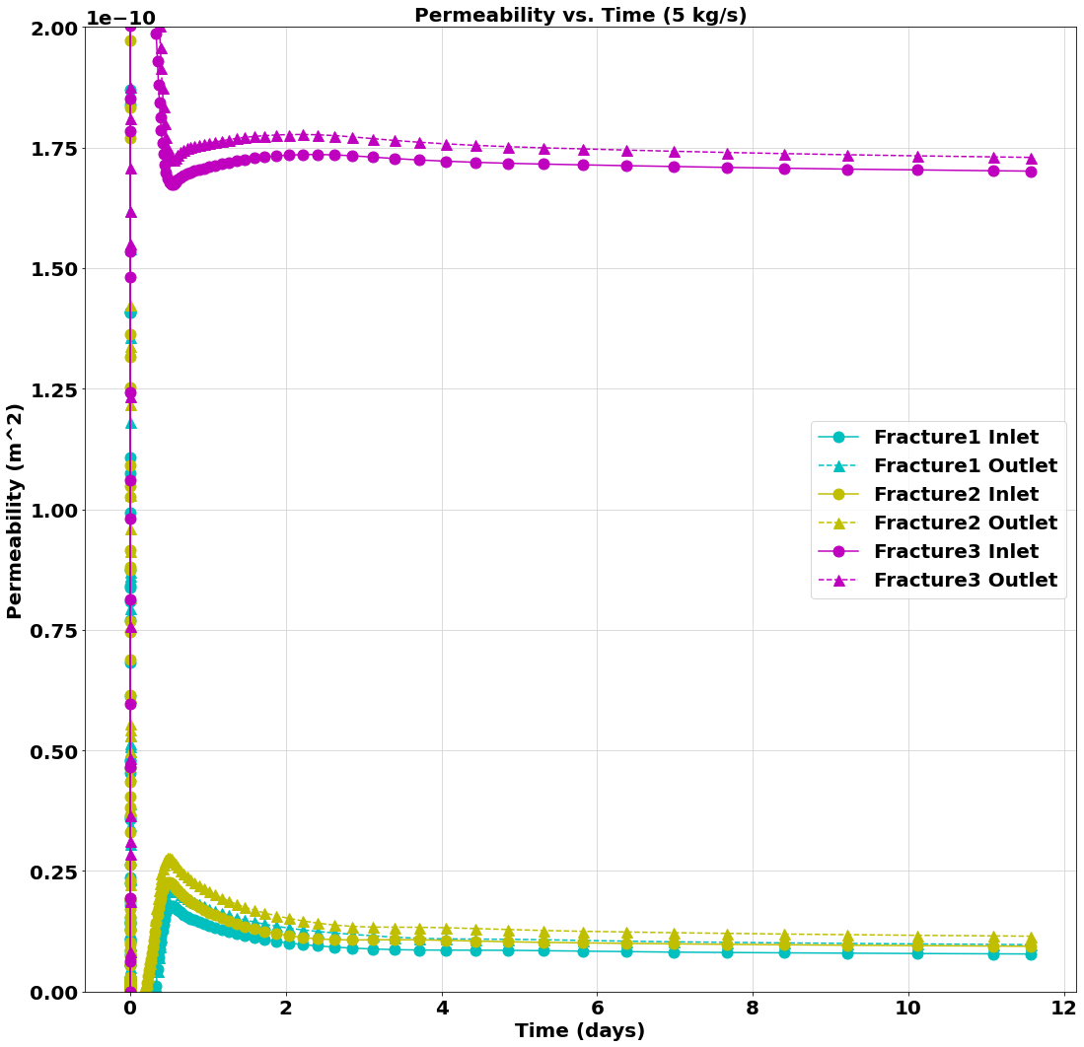
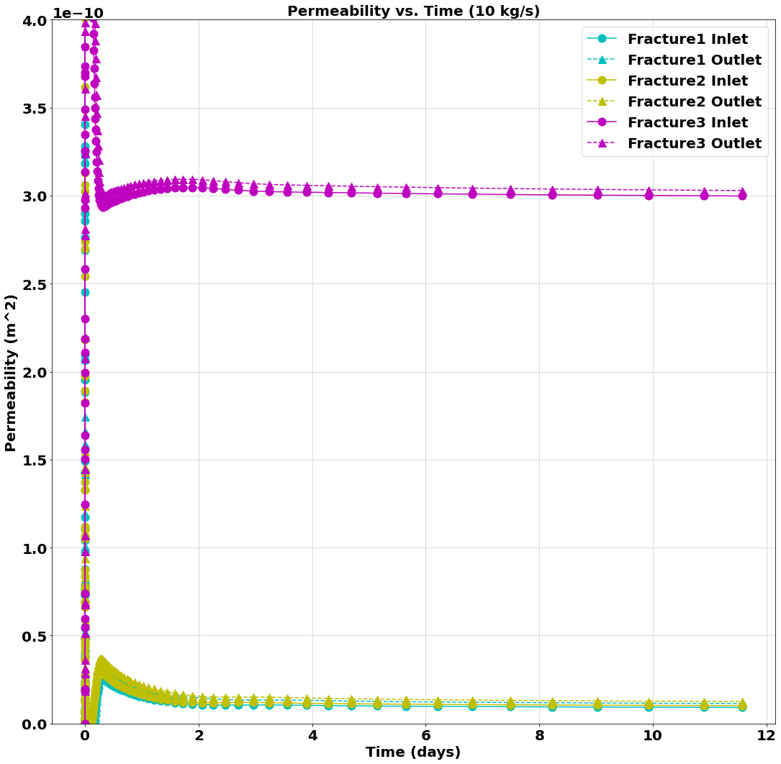
Fracture Permeability
(Fracture Diameter = 0.5 m)
Input file: 2kgs_0.5m.i
Output files: 2kgs_0.5m_CSV.csv
2kgs_0.5m_exodus.e
GitHub Repository Link
Input file: 5kgs_0.5m.i
Output files: 5kgs_0.5m_CSV.csv
5kgs_0.5m_exodus.e
GitHub Repository Link
Input file: 10kgs_0.5m.i
Output files: 10kgs_0.5m_CSV.csv
10kgs_0.5m_exodus.e
GitHub Repository Link

Slide 27
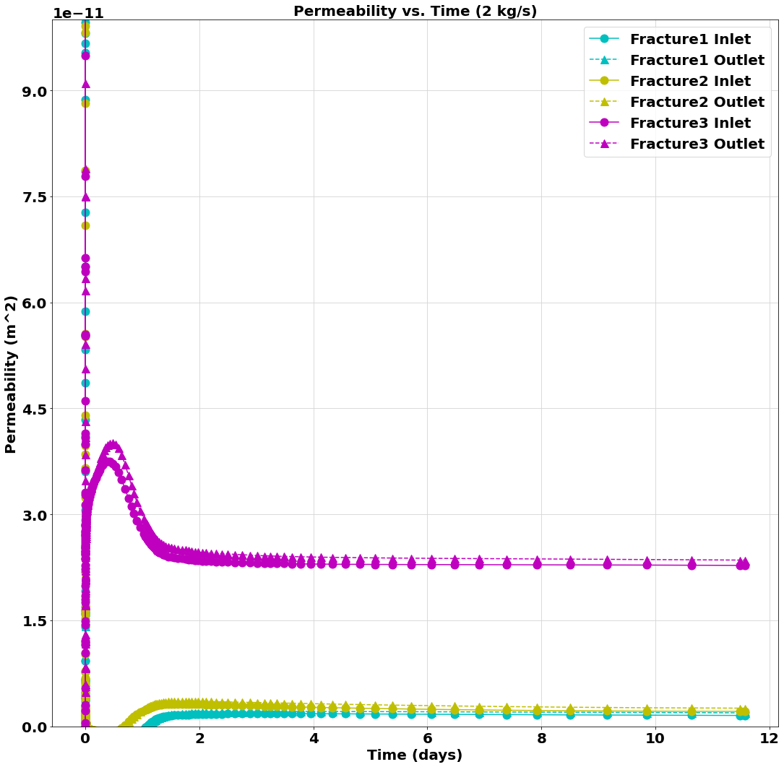
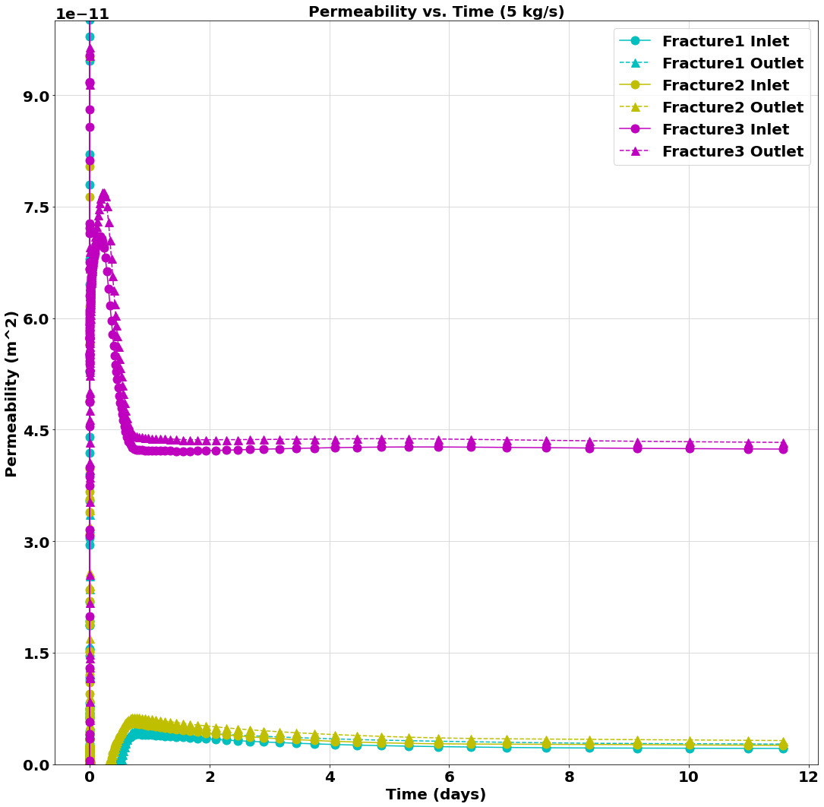
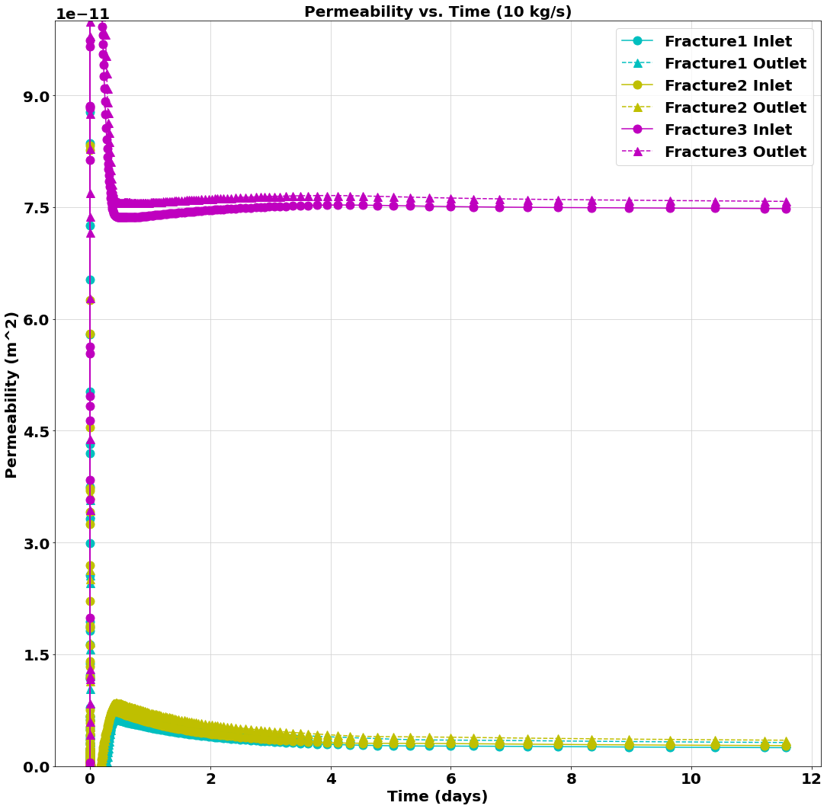
Fracture Permeability
(Fracture Diameter = 1 m)
Input file: 2kgs_1m.i
Output files: 2kgs_1m_CSV.csv
2kgs_1m_exodus.e
GitHub Repository Link
Input file: 5kgs_1m.i
Output files: 5kgs_1m_CSV.csv
5kgs_1m_exodus.e
GitHub Repository Link
Input file: 10kgs_1m.i
Output files: 10kgs_1m_CSV.csv
10kgs_1m_exodus.e
GitHub Repository Link

Slide 28
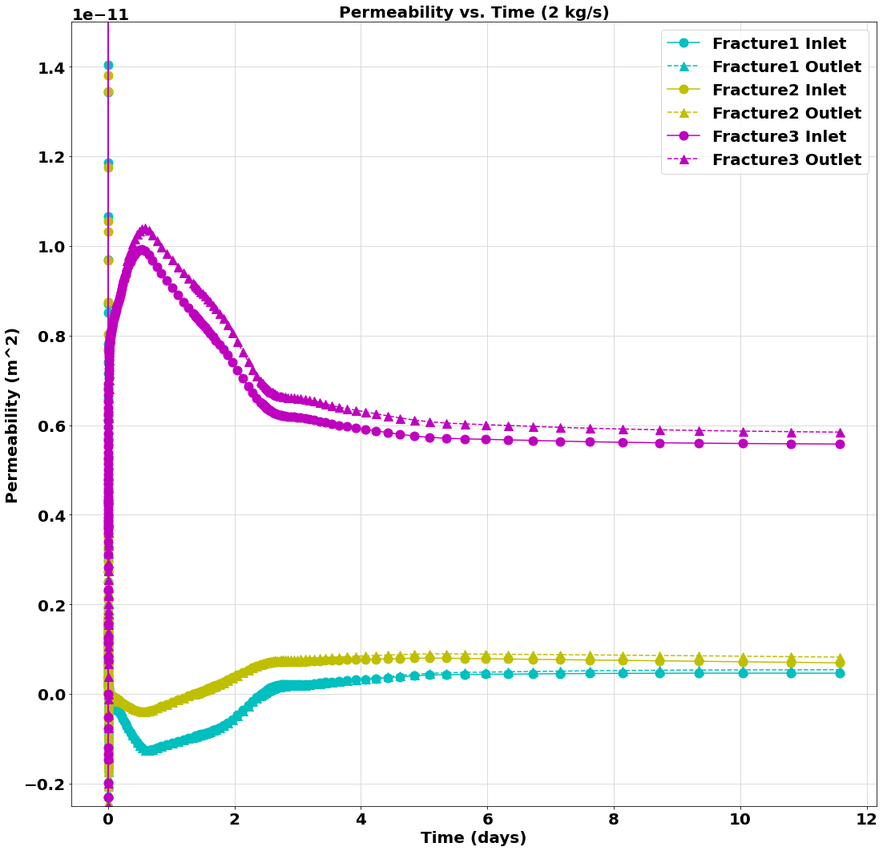
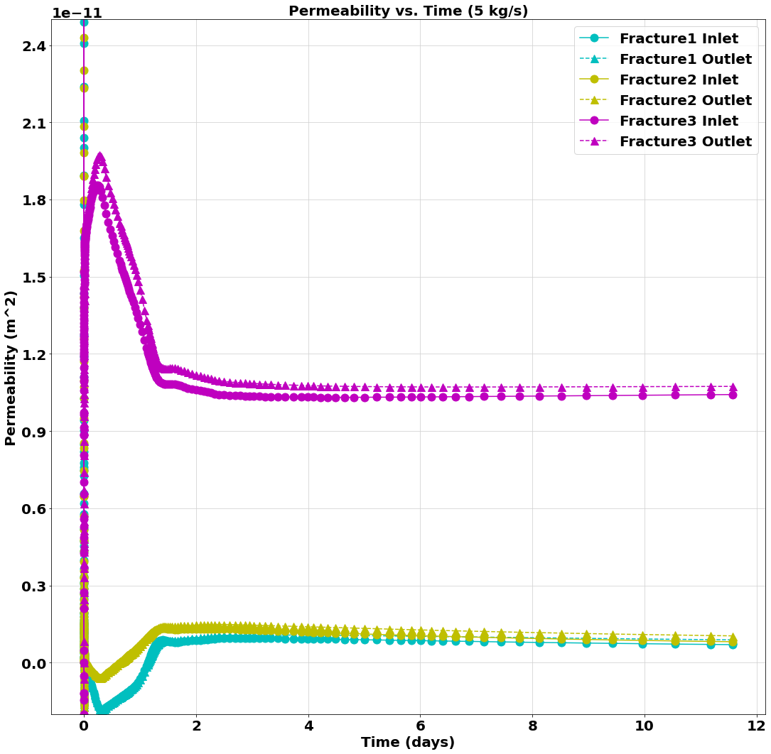
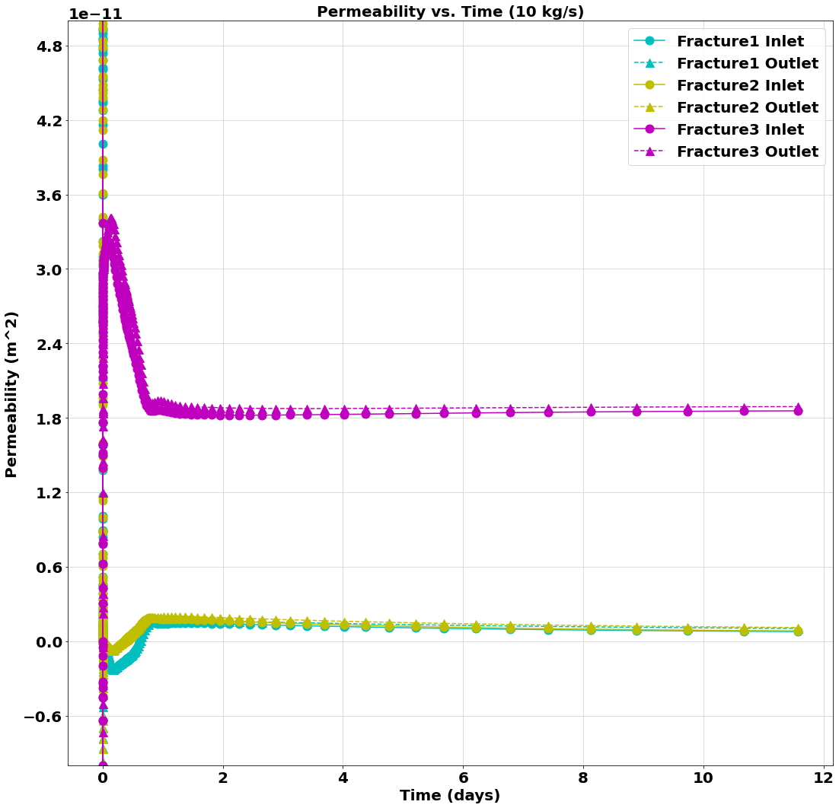
Fracture Permeability
(Fracture Diameter = 2 m)
Input file: 2kgs_2m.i
Output files: 2kgs_2m_CSV.csv
2kgs_2m_exodus.e
GitHub Repository Link
Input file: 5kgs_2m.i
Output files: 5kgs_2m_CSV.csv
5kgs_2m_exodus.e
GitHub Repository Link
Input file: 10kgs_2m.i
Output files: 10kgs_2m_CSV.csv
10kgs_2m_exodus.e
GitHub Repository Link

Slide 29
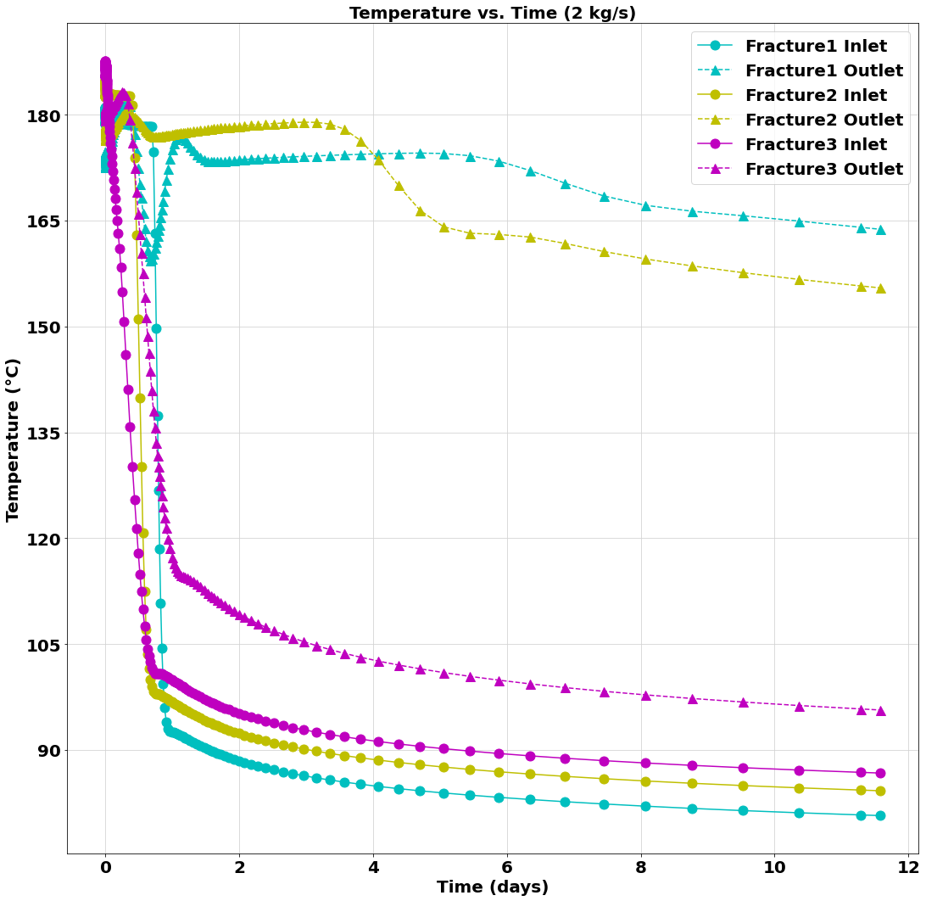
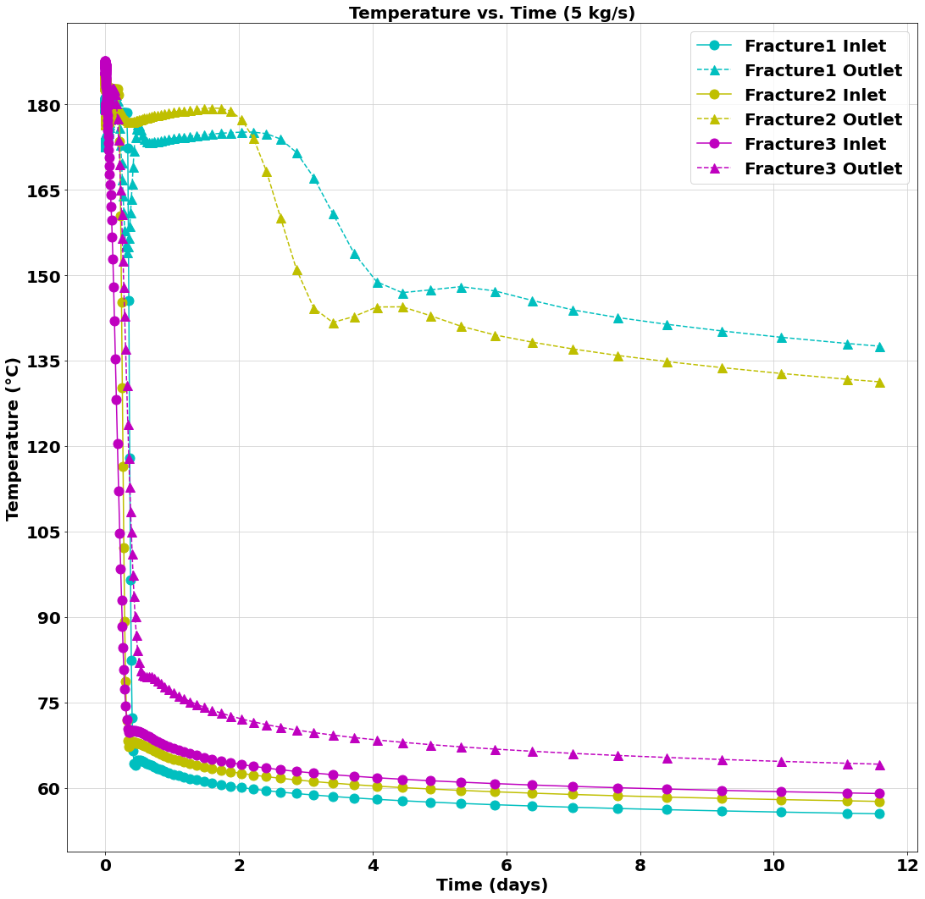
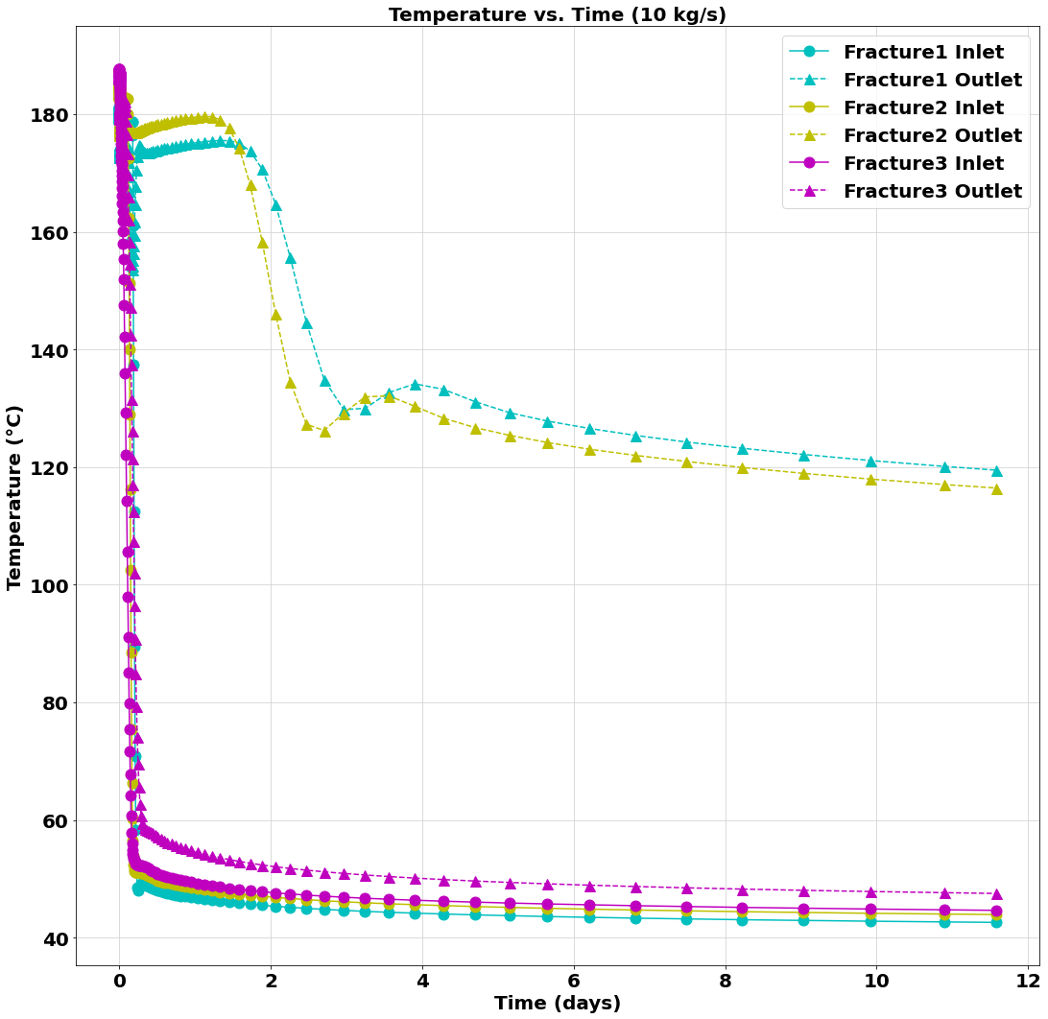
Fracture Inlet and Outlet Temperature (Fracture Diameter = 0.5 m)
Input file: 2kgs_0.5m.i
Output files: 2kgs_0.5m_CSV.csv
2kgs_0.5m_exodus.e
GitHub Repository Link
Input file: 5kgs_0.5m.i
Output files: 5kgs_0.5m_CSV.csv
5kgs_0.5m_exodus.e
GitHub Repository Link
Input file: 10kgs_0.5m.i
Output files: 10kgs_0.5m_CSV.csv
10kgs_0.5m_exodus.e
GitHub Repository Link

Slide 30
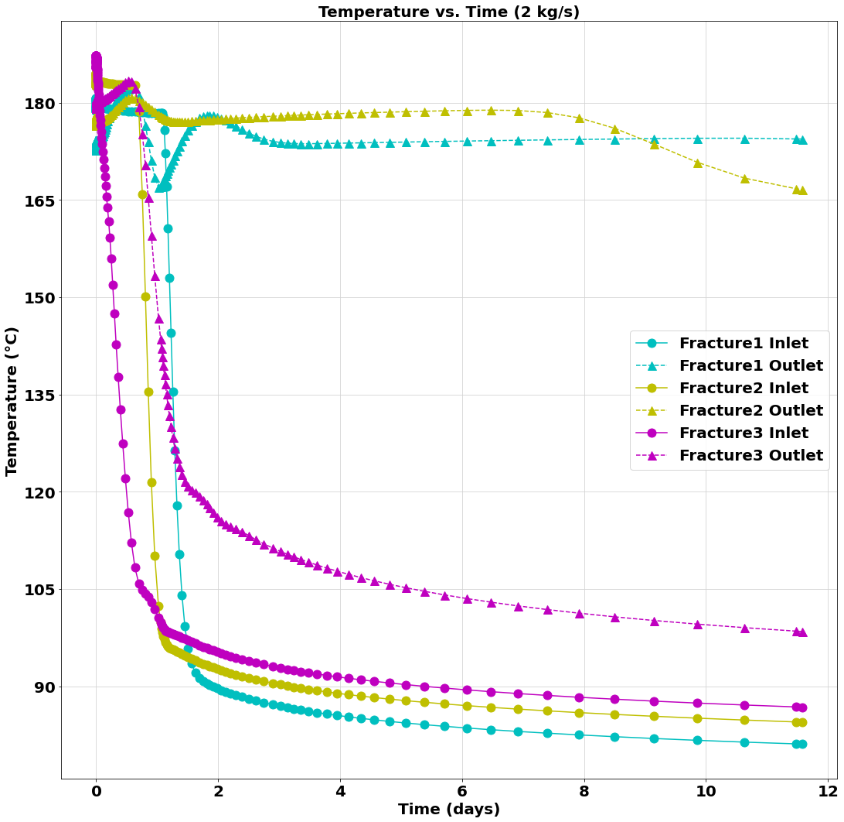
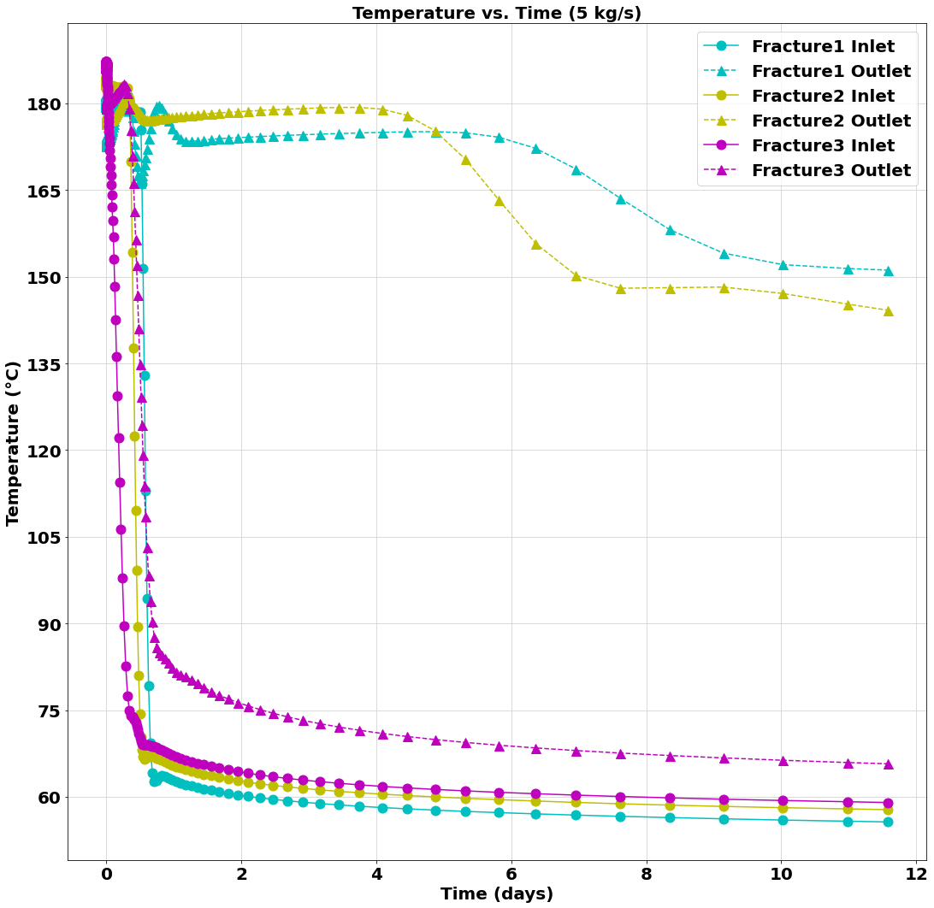
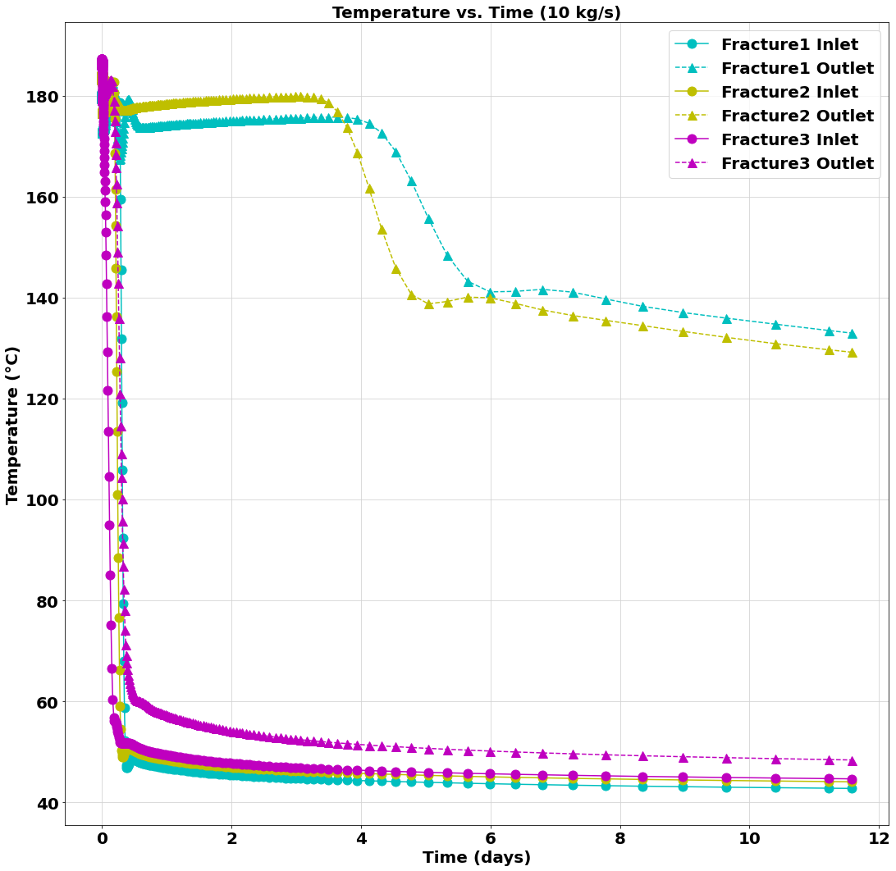
Fracture Inlet and Outlet Temperature (Fracture Diameter = 1 m)
Input file: 2kgs_1m.i
Output files: 2kgs_1m_CSV.csv
2kgs_1m_exodus.e
GitHub Repository Link
Input file: 5kgs_1m.i
Output files: 5kgs_1m_CSV.csv
5kgs_1m_exodus.e
GitHub Repository Link
Input file: 10kgs_1m.i
Output files: 10kgs_1m_CSV.csv
10kgs_1m_exodus.e
GitHub Repository Link

Slide 31
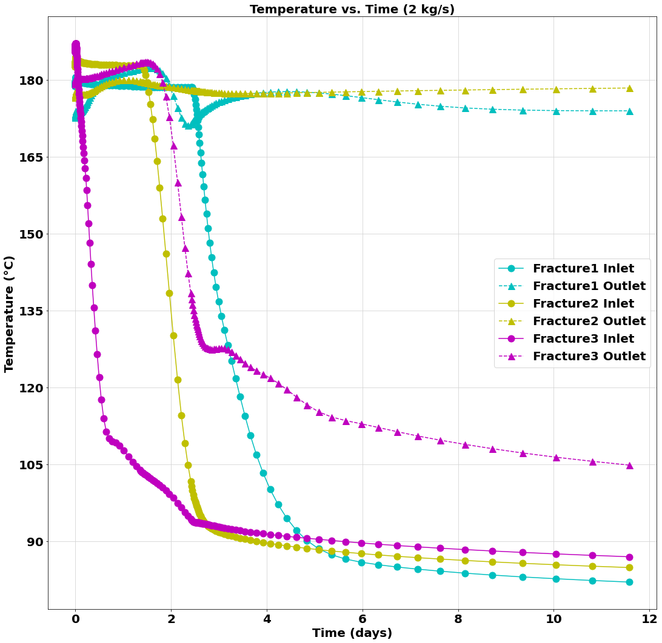
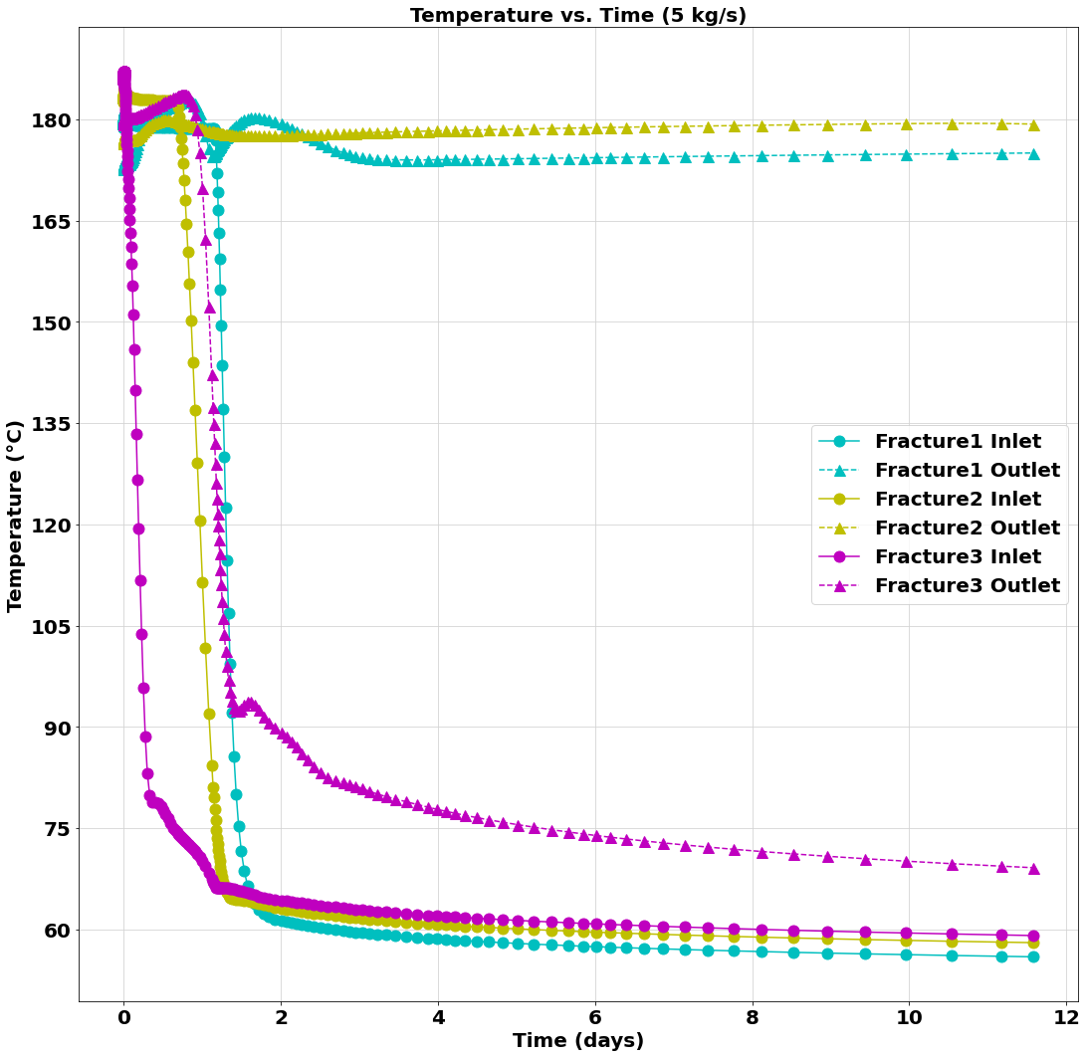
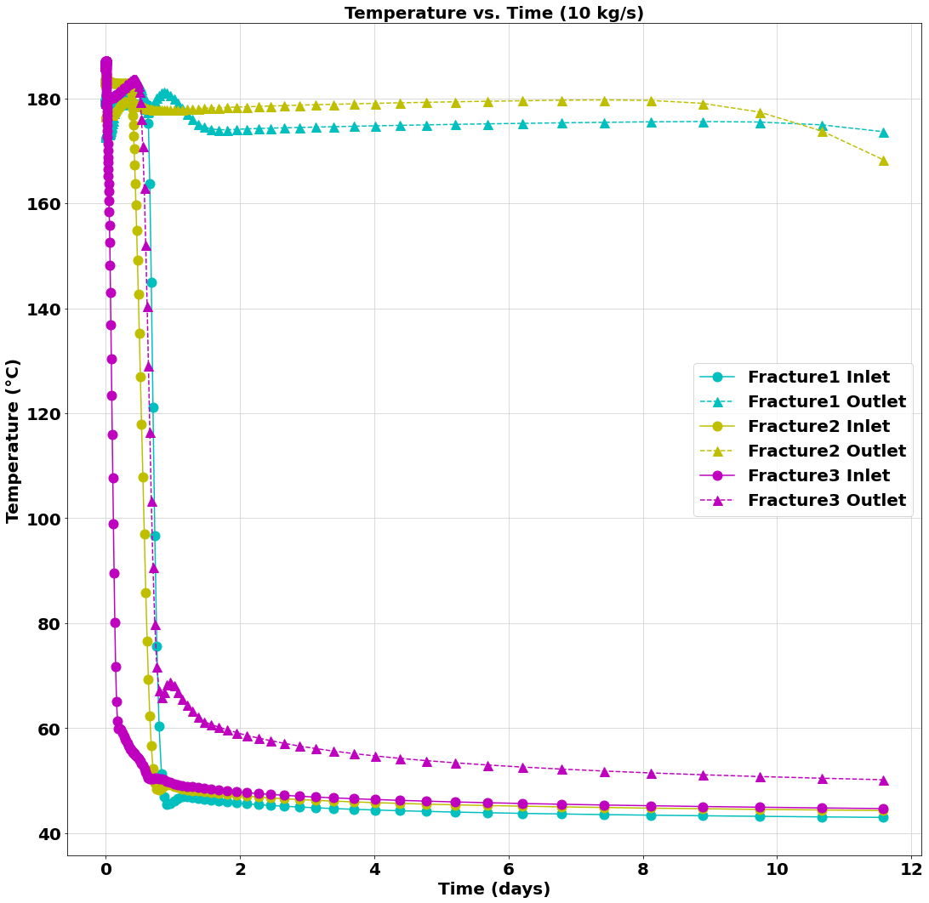
Fracture Inlet and Outlet Temperature (Fracture Diameter = 2 m)
Input file: 2kgs_2m.i
Output files: 2kgs_2m_CSV.csv
2kgs_2m_exodus.e
GitHub Repository Link
Input file: 5kgs_2m.i
Output files: 5kgs_2m_CSV.csv
5kgs_2m_exodus.e
GitHub Repository Link
Input file: 10kgs_2m.i
Output files: 10kgs_2m_CSV.csv
10kgs_2m_exodus.e
GitHub Repository Link

Slide 32
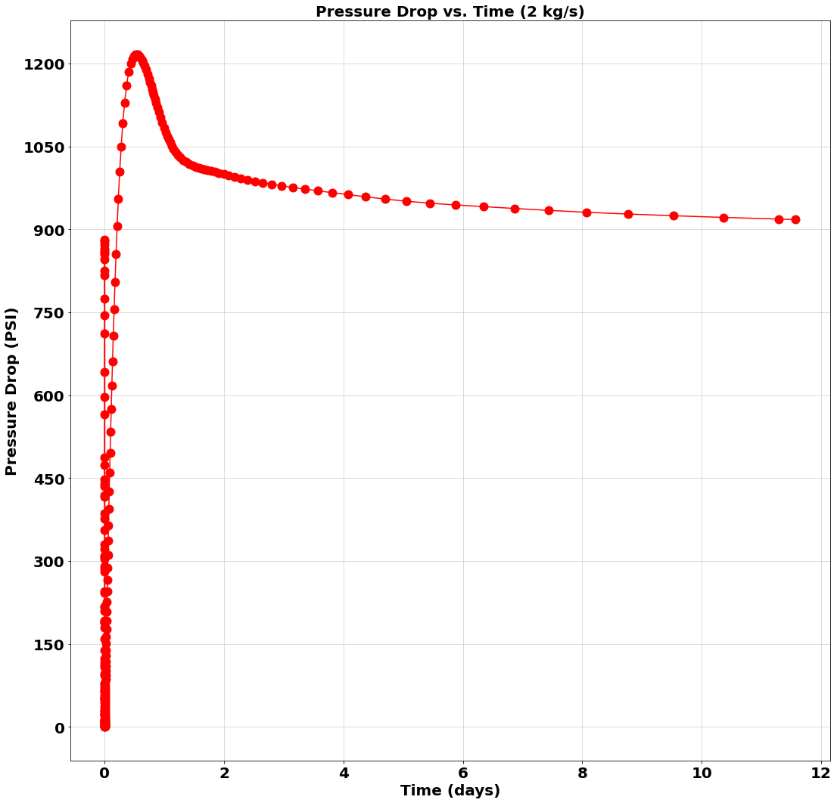
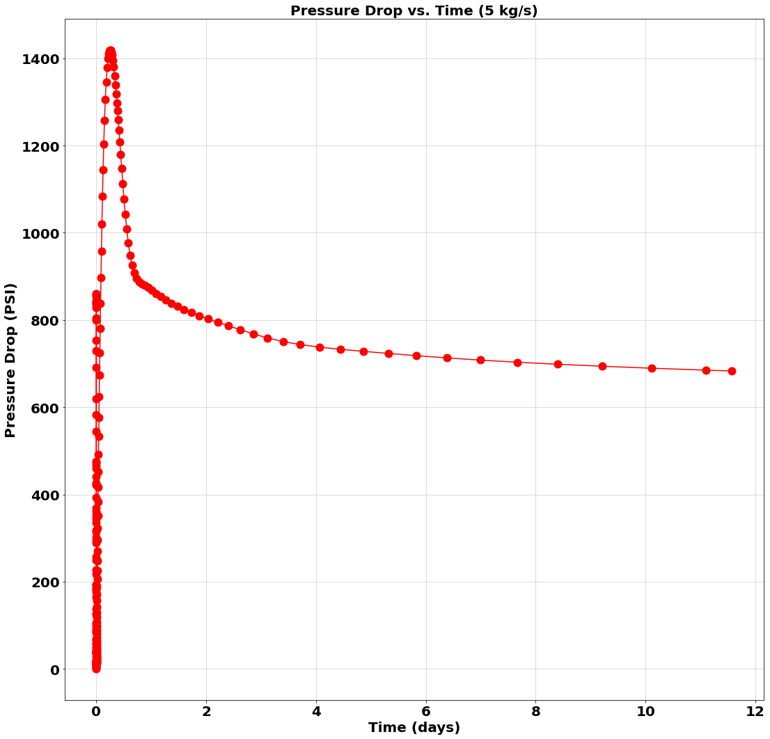
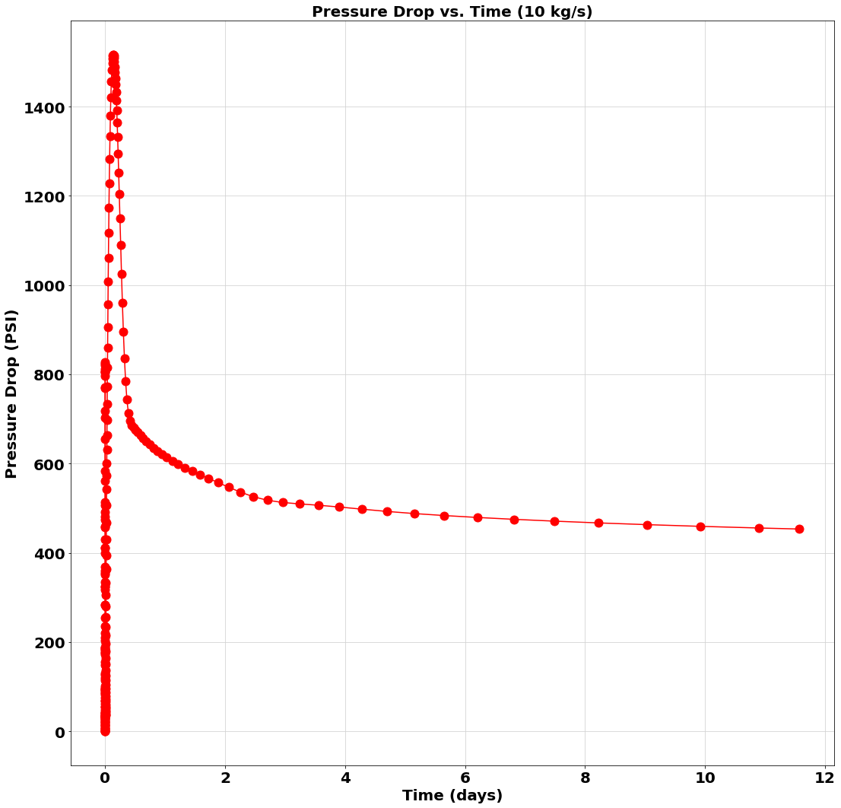
Pressure Drop Across EGS (Fracture Diameter = 0.5 m)
Input file: 2kgs_0.5m.i
Output files: 2kgs_0.5m_CSV.csv
2kgs_0.5m_exodus.e
GitHub Repository Link
Input file: 5kgs_0.5m.i
Output files: 5kgs_0.5m_CSV.csv
5kgs_0.5m_exodus.e
GitHub Repository Link
Input file: 10kgs_0.5m.i
Output files: 10kgs_0.5m_CSV.csv
10kgs_0.5m_exodus.e
GitHub Repository Link

Slide 33
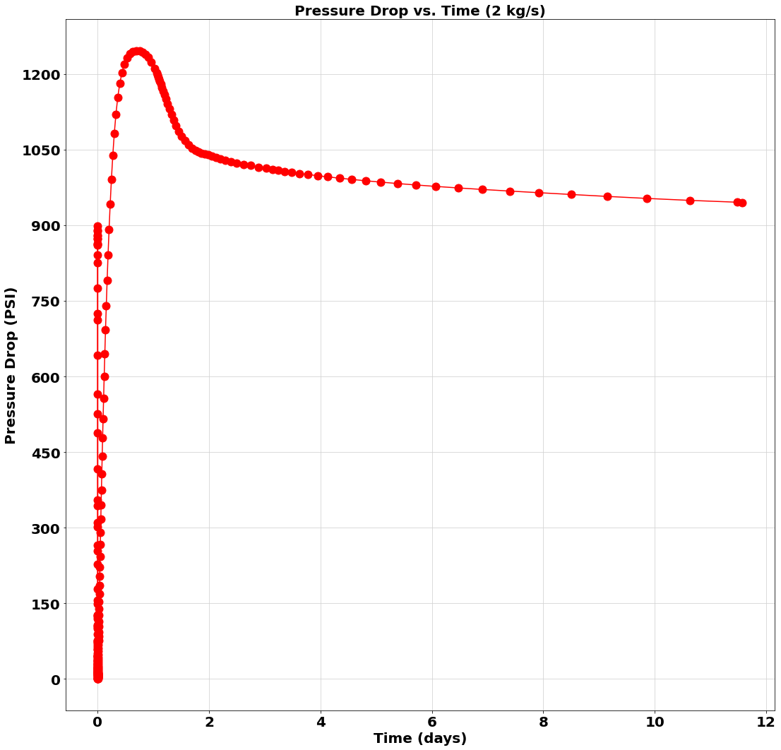
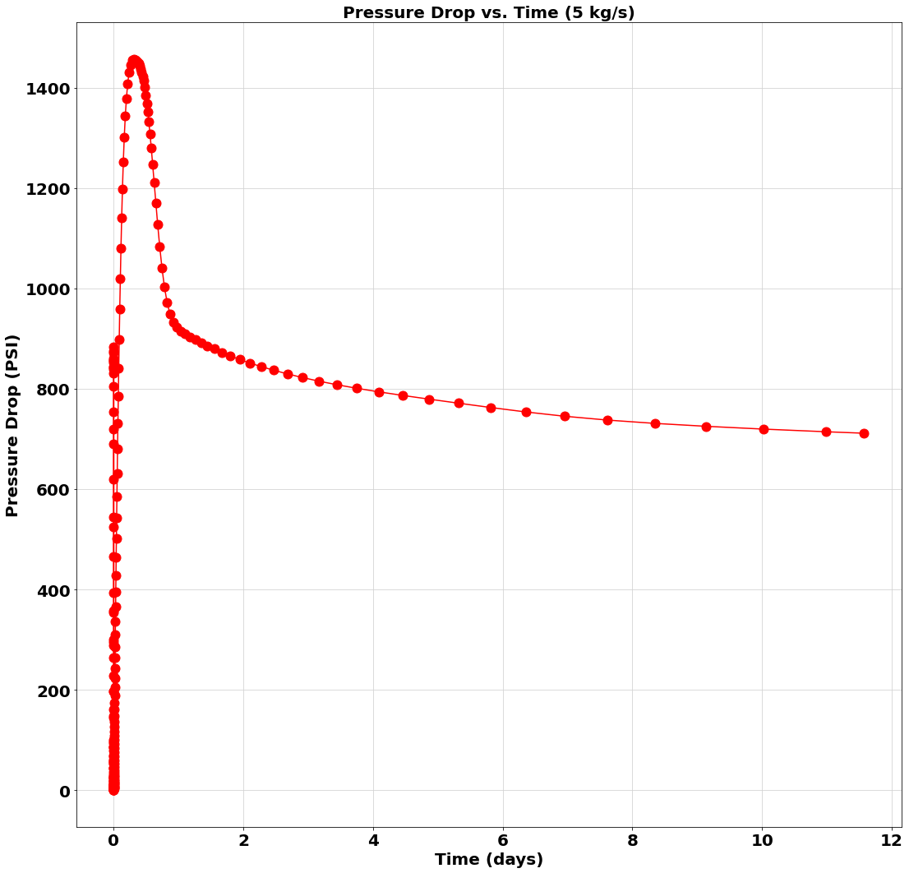
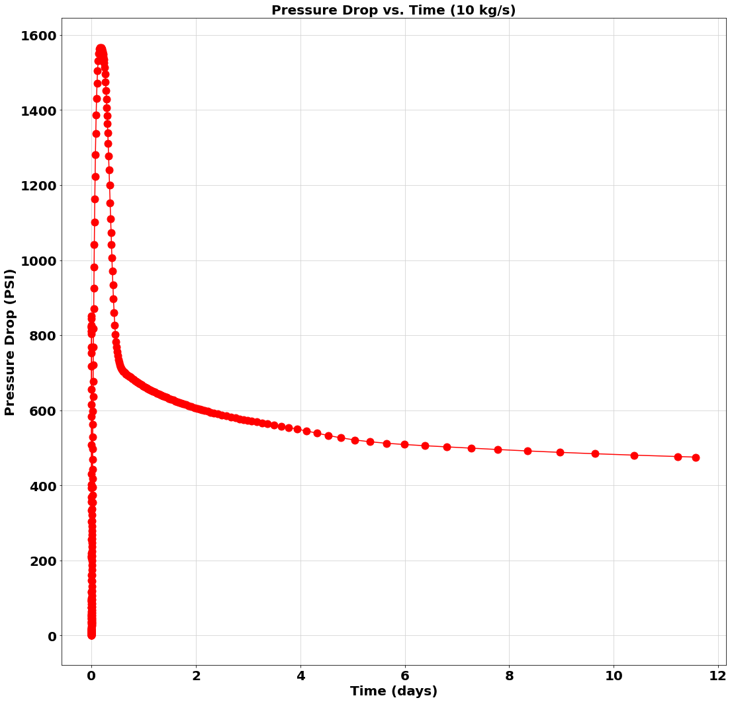
Pressure Drop Across EGS (Fracture Diameter = 1 m)
Input file: 2kgs_1m.i
Output files: 2kgs_1m_CSV.csv
2kgs_1m_exodus.e
GitHub Repository Link
Input file: 5kgs_1m.i
Output files: 5kgs_1m_CSV.csv
5kgs_1m_exodus.e
GitHub Repository Link
Input file: 10kgs_1m.i
Output files: 10kgs_1m_CSV.csv
10kgs_1m_exodus.e
GitHub Repository Link

Slide 34
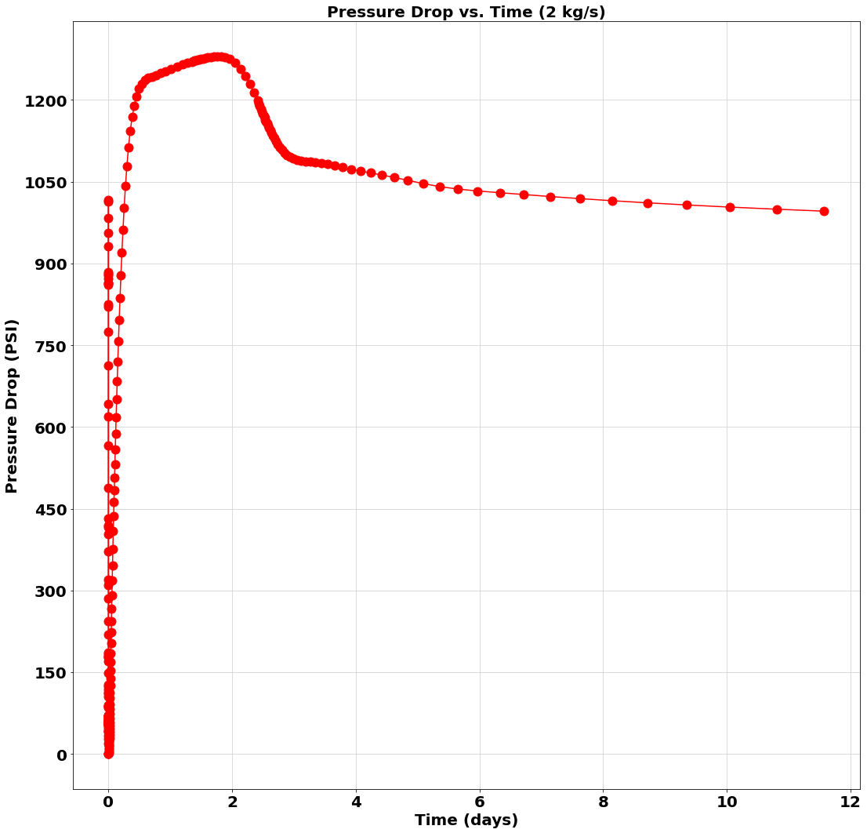


Pressure Drop Across EGS (Fracture Diameter = 2 m)
Input file: 2kgs_2m.i
Output files: 2kgs_2m_CSV.csv
2kgs_2m_exodus.e
GitHub Repository Link
Input file: 5kgs_2m.i
Output files: 5kgs_2m_CSV.csv
5kgs_2m_exodus.e
GitHub Repository Link
Input file: 10kgs_2m.i
Output files: 10kgs_2m_CSV.csv
10kgs_2m_exodus.e
GitHub Repository Link

Slide 35



Pressure Drop Across Fractures
(Fracture Diameter = 0.5 m)
Input file: 2kgs_0.5m.i
Output files: 2kgs_0.5m_CSV.csv
2kgs_0.5m_exodus.e
GitHub Repository Link
Input file: 5kgs_0.5m.i
Output files: 5kgs_0.5m_CSV.csv
5kgs_0.5m_exodus.e
GitHub Repository Link
Input file: 10kgs_0.5m.i
Output files: 10kgs_0.5m_CSV.csv
10kgs_0.5m_exodus.e
GitHub Repository Link

Slide 36



Pressure Drop Across Fractures
(Fracture Diameter = 1 m)
Input file: 2kgs_1m.i
Output files: 2kgs_1m_CSV.csv
2kgs_1m_exodus.e
GitHub Repository Link
Input file: 5kgs_1m.i
Output files: 5kgs_1m_CSV.csv
5kgs_1m_exodus.e
GitHub Repository Link
Input file: 10kgs_1m.i
Output files: 10kgs_1m_CSV.csv
10kgs_1m_exodus.e
GitHub Repository Link

Slide 37



Pressure Drop Across Fractures
(Fracture Diameter = 2 m)
Input file: 2kgs_2m.i
Output files: 2kgs_2m_CSV.csv
2kgs_2m_exodus.e
GitHub Repository Link
Input file: 5kgs_2m.i
Output files: 5kgs_2m_CSV.csv
5kgs_2m_exodus.e
GitHub Repository Link
Input file: 10kgs_2m.i
Output files: 10kgs_2m_CSV.csv
10kgs_2m_exodus.e
GitHub Repository Link

Slide 38



Injection and Production Pressure (Fracture Diameter = 0.5 m)
Input file: 2kgs_0.5m.i
Output files: 2kgs_0.5m_CSV.csv
2kgs_0.5m_exodus.e
GitHub Repository Link
Input file: 5kgs_0.5m.i
Output files: 5kgs_0.5m_CSV.csv
5kgs_0.5m_exodus.e
GitHub Repository Link
Input file: 10kgs_0.5m.i
Output files: 10kgs_0.5m_CSV.csv
10kgs_0.5m_exodus.e
GitHub Repository Link

Slide 39



Injection and Production Pressure (Fracture Diameter = 1 m)
Input file: 2kgs_1m.i
Output files: 2kgs_1m_CSV.csv
2kgs_1m_exodus.e
GitHub Repository Link
Input file: 5kgs_1m.i
Output files: 5kgs_1m_CSV.csv
5kgs_1m_exodus.e
GitHub Repository Link
Input file: 10kgs_1m.i
Output files: 10kgs_1m_CSV.csv
10kgs_1m_exodus.e
GitHub Repository Link

Slide 40



Injection and Production Pressure (Fracture Diameter = 2 m)
Input file: 2kgs_2m.i
Output files: 2kgs_2m_CSV.csv
2kgs_2m_exodus.e
GitHub Repository Link
Input file: 5kgs_2m.i
Output files: 5kgs_2m_CSV.csv
5kgs_2m_exodus.e
GitHub Repository Link
Input file: 10kgs_2m.i
Output files: 10kgs_2m_CSV.csv
10kgs_2m_exodus.e
GitHub Repository Link

Slide 41



Injection Pipe Pressure (Fracture Diameter = 0.5 m)
Input file: 2kgs_0.5m.i
Output files: pipetestclosures_CSV_fracture1_p_0213.csv
‘’ “fracture1_perf1” ”.csv
‘’ “fracture1_perf2” ”.csv
‘’ “fracture2” ”.csv
‘’ “fracture2_perf1” ”.csv
‘’ “fracture2_perf2” ”.csv
‘’ “fracture3” ”.csv
‘’ “injection_pipe” ”.csv
‘’ “pipe2” ”.csv
‘’ “pipe3” ”.csv
‘’ “pipe4” ”.csv
‘’ “pipe5” ”.csv
‘’ “pipe6” ”.csv
‘’ “pipe7” ”.csv
‘’ “production_pipe” ”.csv
2kgs_0.5m_exodus.e
GitHub Repository Link
Input file: 5kgs_0.5m.i
Output files: tenfracturediameter_CSV_fracture1_p_0213.csv
‘’ “fracture1_perf1” ”.csv
‘’ “fracture1_perf2” ”.csv
‘’ “fracture2” ”.csv
‘’ “fracture2_perf1” ”.csv
‘’ “fracture2_perf2” ”.csv
‘’ “fracture3” ”.csv
‘’ “injection_pipe” ”.csv
‘’ “pipe2” ”.csv
‘’ “pipe3” ”.csv
‘’ “pipe4” ”.csv
‘’ “pipe5” ”.csv
‘’ “pipe6” ”.csv
‘’ “pipe7” ”.csv
‘’ “production_pipe” ”.csv
5kgs_0.5m_exodus.e
GitHub Repository Link
Input file: 10kgs_0.5m.i
Output files: finalflowrate_CSV_fracture1_p_0213.csv
‘’ “fracture1_perf1” ”.csv
‘’ “fracture1_perf2” ”.csv
‘’ “fracture2” ”.csv
‘’ “fracture2_perf1” ”.csv
‘’ “fracture2_perf2” ”.csv
‘’ “fracture3” ”.csv
‘’ “injection_pipe” ”.csv
‘’ “pipe2” ”.csv
‘’ “pipe3” ”.csv
‘’ “pipe4” ”.csv
‘’ “pipe5” ”.csv
‘’ “pipe6” ”.csv
‘’ “pipe7” ”.csv
‘’ “production_pipe” ”.csv
10kgs_0.5m_exodus.e
GitHub Repository Link

Slide 42



Injection Pipe Pressure (Fracture Diameter = 1 m)
Input file: 2kgs_1m.i
Output files: pipetestclosures_CSV_fracture1_p_0232.csv
‘’ “fracture1_perf1” ”.csv
‘’ “fracture1_perf2” ”.csv
‘’ “fracture2” ”.csv
‘’ “fracture2_perf1” ”.csv
‘’ “fracture2_perf2” ”.csv
‘’ “fracture3” ”.csv
‘’ “injection_pipe” ”.csv
‘’ “pipe2” ”.csv
‘’ “pipe3” ”.csv
‘’ “pipe4” ”.csv
‘’ “pipe5” ”.csv
‘’ “pipe6” ”.csv
‘’ “pipe7” ”.csv
‘’ “production_pipe” ”.csv
2kgs_1m_exodus.e
GitHub Repository Link
Input file: 5kgs_1m.i
Output files: tenfracturediameter_CSV_fracture1_p_0204.csv
‘’ “fracture1_perf1” ”.csv
‘’ “fracture1_perf2” ”.csv
‘’ “fracture2” ”.csv
‘’ “fracture2_perf1” ”.csv
‘’ “fracture2_perf2” ”.csv
‘’ “fracture3” ”.csv
‘’ “injection_pipe” ”.csv
‘’ “pipe2” ”.csv
‘’ “pipe3” ”.csv
‘’ “pipe4” ”.csv
‘’ “pipe5” ”.csv
‘’ “pipe6” ”.csv
‘’ “pipe7” ”.csv
‘’ “production_pipe” ”.csv
5kgs_1m_exodus.e
GitHub Repository Link
Input file: 10kgs_1m.i
Output files: finalflowrate_CSV_fracture1_p_0277.csv
‘’ “fracture1_perf1” ”.csv
‘’ “fracture1_perf2” ”.csv
‘’ “fracture2” ”.csv
‘’ “fracture2_perf1” ”.csv
‘’ “fracture2_perf2” ”.csv
‘’ “fracture3” ”.csv
‘’ “injection_pipe” ”.csv
‘’ “pipe2” ”.csv
‘’ “pipe3” ”.csv
‘’ “pipe4” ”.csv
‘’ “pipe5” ”.csv
‘’ “pipe6” ”.csv
‘’ “pipe7” ”.csv
‘’ “production_pipe” ”.csv
10kgs_1m_exodus.e
GitHub Repository Link

Slide 43



Injection Pipe Pressure (Fracture Diameter = 2 m)
Input file: 2kgs_2m.i
Output files: pipetestclosures_CSV_fracture1_p_0258.csv
‘’ “fracture1_perf1” ”.csv
‘’ “fracture1_perf2” ”.csv
‘’ “fracture2” ”.csv
‘’ “fracture2_perf1” ”.csv
‘’ “fracture2_perf2” ”.csv
‘’ “fracture3” ”.csv
‘’ “injection_pipe” ”.csv
‘’ “pipe2” ”.csv
‘’ “pipe3” ”.csv
‘’ “pipe4” ”.csv
‘’ “pipe5” ”.csv
‘’ “pipe6” ”.csv
‘’ “pipe7” ”.csv
‘’ “production_pipe” ”.csv
2kgs_2m_exodus.e
GitHub Repository Link
Input file: 5kgs_2m.i
Output files: tenfracturediameter_CSV_fracture1_p_0272.csv
‘’ “fracture1_perf1” ”.csv
‘’ “fracture1_perf2” ”.csv
‘’ “fracture2” ”.csv
‘’ “fracture2_perf1” ”.csv
‘’ “fracture2_perf2” ”.csv
‘’ “fracture3” ”.csv
‘’ “injection_pipe” ”.csv
‘’ “pipe2” ”.csv
‘’ “pipe3” ”.csv
‘’ “pipe4” ”.csv
‘’ “pipe5” ”.csv
‘’ “pipe6” ”.csv
‘’ “pipe7” ”.csv
‘’ “production_pipe” ”.csv
5kgs_2m_exodus.e
GitHub Repository Link
Input file: 10kgs_2m.i
Output files: finalflowrate_CSV_fracture1_p_0213.csv
‘’ “fracture1_perf1” ”.csv
‘’ “fracture1_perf2” ”.csv
‘’ “fracture2” ”.csv
‘’ “fracture2_perf1” ”.csv
‘’ “fracture2_perf2” ”.csv
‘’ “fracture3” ”.csv
‘’ “injection_pipe” ”.csv
‘’ “pipe2” ”.csv
‘’ “pipe3” ”.csv
‘’ “pipe4” ”.csv
‘’ “pipe5” ”.csv
‘’ “pipe6” ”.csv
‘’ “pipe7” ”.csv
‘’ “production_pipe” ”.csv
10kgs_2m_exodus.e
GitHub Repository Link

Slide 44



Pressure Across EGS
(Fracture Diameter = 0.5 m)
Input file: 2kgs_0.5m.i
Output files: pipetestclosures_CSV_fracture1_p_0213.csv
‘’ “fracture1_perf1” ”.csv
‘’ “fracture1_perf2” ”.csv
‘’ “fracture2” ”.csv
‘’ “fracture2_perf1” ”.csv
‘’ “fracture2_perf2” ”.csv
‘’ “fracture3” ”.csv
‘’ “injection_pipe” ”.csv
‘’ “pipe2” ”.csv
‘’ “pipe3” ”.csv
‘’ “pipe4” ”.csv
‘’ “pipe5” ”.csv
‘’ “pipe6” ”.csv
‘’ “pipe7” ”.csv
‘’ “production_pipe” ”.csv
2kgs_0.5m_exodus.e
GitHub Repository Link
Input file: 5kgs_0.5m.i
Output files: tenfracturediameter_CSV_fracture1_p_0213.csv
‘’ “fracture1_perf1” ”.csv
‘’ “fracture1_perf2” ”.csv
‘’ “fracture2” ”.csv
‘’ “fracture2_perf1” ”.csv
‘’ “fracture2_perf2” ”.csv
‘’ “fracture3” ”.csv
‘’ “injection_pipe” ”.csv
‘’ “pipe2” ”.csv
‘’ “pipe3” ”.csv
‘’ “pipe4” ”.csv
‘’ “pipe5” ”.csv
‘’ “pipe6” ”.csv
‘’ “pipe7” ”.csv
‘’ “production_pipe” ”.csv
5kgs_0.5m_exodus.e
GitHub Repository Link
Input file: 10kgs_0.5m.i
Output files: finalflowrate_CSV_fracture1_p_0213.csv
‘’ “fracture1_perf1” ”.csv
‘’ “fracture1_perf2” ”.csv
‘’ “fracture2” ”.csv
‘’ “fracture2_perf1” ”.csv
‘’ “fracture2_perf2” ”.csv
‘’ “fracture3” ”.csv
‘’ “injection_pipe” ”.csv
‘’ “pipe2” ”.csv
‘’ “pipe3” ”.csv
‘’ “pipe4” ”.csv
‘’ “pipe5” ”.csv
‘’ “pipe6” ”.csv
‘’ “pipe7” ”.csv
‘’ “production_pipe” ”.csv
10kgs_0.5m_exodus.e
GitHub Repository Link

Slide 45



Pressure Across EGS
(Fracture Diameter = 1 m)
Input file: 2kgs_1m.i
Output files: pipetestclosures_CSV_fracture1_p_0232.csv
‘’ “fracture1_perf1” ”.csv
‘’ “fracture1_perf2” ”.csv
‘’ “fracture2” ”.csv
‘’ “fracture2_perf1” ”.csv
‘’ “fracture2_perf2” ”.csv
‘’ “fracture3” ”.csv
‘’ “injection_pipe” ”.csv
‘’ “pipe2” ”.csv
‘’ “pipe3” ”.csv
‘’ “pipe4” ”.csv
‘’ “pipe5” ”.csv
‘’ “pipe6” ”.csv
‘’ “pipe7” ”.csv
‘’ “production_pipe” ”.csv
2kgs_1m_exodus.e
GitHub Repository Link
Input file: 5kgs_1m.i
Output files: tenfracturediameter_CSV_fracture1_p_0204.csv
‘’ “fracture1_perf1” ”.csv
‘’ “fracture1_perf2” ”.csv
‘’ “fracture2” ”.csv
‘’ “fracture2_perf1” ”.csv
‘’ “fracture2_perf2” ”.csv
‘’ “fracture3” ”.csv
‘’ “injection_pipe” ”.csv
‘’ “pipe2” ”.csv
‘’ “pipe3” ”.csv
‘’ “pipe4” ”.csv
‘’ “pipe5” ”.csv
‘’ “pipe6” ”.csv
‘’ “pipe7” ”.csv
‘’ “production_pipe” ”.csv
5kgs_1m_exodus.e
GitHub Repository Link
Input file: 10kgs_1m.i
Output files: finalflowrate_CSV_fracture1_p_0277.csv
‘’ “fracture1_perf1” ”.csv
‘’ “fracture1_perf2” ”.csv
‘’ “fracture2” ”.csv
‘’ “fracture2_perf1” ”.csv
‘’ “fracture2_perf2” ”.csv
‘’ “fracture3” ”.csv
‘’ “injection_pipe” ”.csv
‘’ “pipe2” ”.csv
‘’ “pipe3” ”.csv
‘’ “pipe4” ”.csv
‘’ “pipe5” ”.csv
‘’ “pipe6” ”.csv
‘’ “pipe7” ”.csv
‘’ “production_pipe” ”.csv
10kgs_1m_exodus.e
GitHub Repository Link

Slide 46



Pressure Across EGS
(Fracture Diameter = 2 m)
Input file: 2kgs_2m.i
Output files: pipetestclosures_CSV_fracture1_p_0258.csv
‘’ “fracture1_perf1” ”.csv
‘’ “fracture1_perf2” ”.csv
‘’ “fracture2” ”.csv
‘’ “fracture2_perf1” ”.csv
‘’ “fracture2_perf2” ”.csv
‘’ “fracture3” ”.csv
‘’ “injection_pipe” ”.csv
‘’ “pipe2” ”.csv
‘’ “pipe3” ”.csv
‘’ “pipe4” ”.csv
‘’ “pipe5” ”.csv
‘’ “pipe6” ”.csv
‘’ “pipe7” ”.csv
‘’ “production_pipe” ”.csv
2kgs_2m_exodus.e
GitHub Repository Link
Input file: 5kgs_2m.i
Output files: tenfracturediameter_CSV_fracture1_p_0272.csv
‘’ “fracture1_perf1” ”.csv
‘’ “fracture1_perf2” ”.csv
‘’ “fracture2” ”.csv
‘’ “fracture2_perf1” ”.csv
‘’ “fracture2_perf2” ”.csv
‘’ “fracture3” ”.csv
‘’ “injection_pipe” ”.csv
‘’ “pipe2” ”.csv
‘’ “pipe3” ”.csv
‘’ “pipe4” ”.csv
‘’ “pipe5” ”.csv
‘’ “pipe6” ”.csv
‘’ “pipe7” ”.csv
‘’ “production_pipe” ”.csv
5kgs_2m_exodus.e
GitHub Repository Link
Input file: 10kgs_2m.i
Output files: finalflowrate_CSV_fracture1_p_0213.csv
‘’ “fracture1_perf1” ”.csv
‘’ “fracture1_perf2” ”.csv
‘’ “fracture2” ”.csv
‘’ “fracture2_perf1” ”.csv
‘’ “fracture2_perf2” ”.csv
‘’ “fracture3” ”.csv
‘’ “injection_pipe” ”.csv
‘’ “pipe2” ”.csv
‘’ “pipe3” ”.csv
‘’ “pipe4” ”.csv
‘’ “pipe5” ”.csv
‘’ “pipe6” ”.csv
‘’ “pipe7” ”.csv
‘’ “production_pipe” ”.csv
10kgs_2m_exodus.e
GitHub Repository Link

Slide 47
2 Fracture Zones Study
No Open Hole Fracture 3

Slide 48

Paraview at ~= 1,000,000s, 2 fracture zones

Slide 49



Flow Distribution Percentage (Fracture Diameter = 0.5 m)
Input file: 2kgs_0.5m_2fracs.i
Output files: 2kgs_0.5m_2fracs_CSV.csv
2kgs_0.5m_2fracs_exodus.e
GitHub Repository Link
Input file: 5kgs_0.5m_2fracs.i
Output files: 5kgs_0.5m_2fracs_CSV.csv
5kgs_0.5m_2fracs_exodus.e
GitHub Repository Link
Input file: 10kgs_0.5m_2fracs.i
Output files: 10kgs_0.5m_2fracs_CSV.csv
10kgs_0.5m_2fracs_exodus.e
GitHub Repository Link

Slide 50



Flow Distribution Percentage (Fracture Diameter = 1 m)
Input file:
2kgs_1m_2fracs.i
Output files: 2kgs_1m_2fracs_CSV.csv
2kgs_1m_2fracs_exodus.e
GitHub Repository Link
Input file:
5kgs_1m_2fracs.i
Output files: 5kgs_1m_2fracs_CSV.csv
5kgs_1m_2fracs_exodus.e
GitHub Repository Link
Input file:
10kgs_1m_2fracs.i
Output files: 10kgs_1m_2fracs_CSV.csv
10kgs_1m_2fracs_exodus.e
GitHub Repository Link

Slide 51



Flow Distribution Percentage (Fracture Diameter = 2 m)
Input file:
2kgs_2m_2fracs.i
Output files: 2kgs_2m_2fracs_CSV.csv
2kgs_2m_2fracs_exodus.e
GitHub Repository Link
Input file:
5kgs_2m_2fracs.i
Output files: 5kgs_2m_2fracs_CSV.csv
5kgs_2m_2fracs_exodus.e
GitHub Repository Link
Input file:
10kgs_2m_2fracs.i
Output files: 10kgs_2m_2fracs_CSV.csv
10kgs_2m_2fracs_exodus.e
GitHub Repository Link

Slide 52



Flowrate Inlet and Outlet
(Fracture Diameter = 0.5 m)
Input file: 2kgs_0.5m_2fracs.i
Output files: 2kgs_0.5m_2fracs_CSV.csv
2kgs_0.5m_2fracs_exodus.e
GitHub Repository Link
Input file: 5kgs_0.5m_2fracs.i
Output files: 5kgs_0.5m_2fracs_CSV.csv
5kgs_0.5m_2fracs_exodus.e
GitHub Repository Link
Input file: 10kgs_0.5m_2fracs.i
Output files: 10kgs_0.5m_2fracs_CSV.csv
10kgs_0.5m_2fracs_exodus.e
GitHub Repository Link

Slide 53



Flowrate Inlet and Outlet
(Fracture Diameter = 1 m)
Input file:
2kgs_1m_2fracs.i
Output files: 2kgs_1m_2fracs_CSV.csv
2kgs_1m_2fracs_exodus.e
GitHub Repository Link
Input file:
5kgs_1m_2fracs.i
Output files: 5kgs_1m_2fracs_CSV.csv
5kgs_1m_2fracs_exodus.e
GitHub Repository Link
Input file:
10kgs_1m_2fracs.i
Output files: 10kgs_1m_2fracs_CSV.csv
10kgs_1m_2fracs_exodus.e
GitHub Repository Link

Slide 54



Flowrate Inlet and Outlet
(Fracture Diameter = 2 m)
Input file:
2kgs_2m_2fracs.i
Output files: 2kgs_2m_2fracs_CSV.csv
2kgs_2m_2fracs_exodus.e
GitHub Repository Link
Input file:
5kgs_2m_2fracs.i
Output files: 5kgs_2m_2fracs_CSV.csv
5kgs_2m_2fracs_exodus.e
GitHub Repository Link
Input file:
10kgs_2m_2fracs.i
Output files: 10kgs_2m_2fracs_CSV.csv
10kgs_2m_2fracs_exodus.e
GitHub Repository Link

Slide 55



Fracture Permeability
(Fracture Diameter = 0.5 m)
Input file: 2kgs_0.5m_2fracs.i
Output files: 2kgs_0.5m_2fracs_CSV.csv
2kgs_0.5m_2fracs_exodus.e
GitHub Repository Link
Input file: 5kgs_0.5m_2fracs.i
Output files: 5kgs_0.5m_2fracs_CSV.csv
5kgs_0.5m_2fracs_exodus.e
GitHub Repository Link
Input file: 10kgs_0.5m_2fracs.i
Output files: 10kgs_0.5m_2fracs_CSV.csv
10kgs_0.5m_2fracs_exodus.e
GitHub Repository Link

Slide 56



Fracture Permeability
(Fracture Diameter = 1 m)
Input file:
2kgs_1m_2fracs.i
Output files: 2kgs_1m_2fracs_CSV.csv
2kgs_1m_2fracs_exodus.e
GitHub Repository Link
Input file:
5kgs_1m_2fracs.i
Output files: 5kgs_1m_2fracs_CSV.csv
5kgs_1m_2fracs_exodus.e
GitHub Repository Link
Input file:
10kgs_1m_2fracs.i
Output files: 10kgs_1m_2fracs_CSV.csv
10kgs_1m_2fracs_exodus.e
GitHub Repository Link

Slide 57



Fracture Permeability
(Fracture Diameter = 2 m)
Input file:
2kgs_2m_2fracs.i
Output files: 2kgs_2m_2fracs_CSV.csv
2kgs_2m_2fracs_exodus.e
GitHub Repository Link
Input file:
5kgs_2m_2fracs.i
Output files: 5kgs_2m_2fracs_CSV.csv
5kgs_2m_2fracs_exodus.e
GitHub Repository Link
Input file:
10kgs_2m_2fracs.i
Output files: 10kgs_2m_2fracs_CSV.csv
10kgs_2m_2fracs_exodus.e
GitHub Repository Link

Slide 58



Fracture Inlet and Outlet Temperature (Fracture Diameter = 0.5 m)
Input file: 2kgs_0.5m_2fracs.i
Output files: 2kgs_0.5m_2fracs_CSV.csv
2kgs_0.5m_2fracs_exodus.e
GitHub Repository Link
Input file: 5kgs_0.5m_2fracs.i
Output files: 5kgs_0.5m_2fracs_CSV.csv
5kgs_0.5m_2fracs_exodus.e
GitHub Repository Link
Input file: 10kgs_0.5m_2fracs.i
Output files: 10kgs_0.5m_2fracs_CSV.csv
10kgs_0.5m_2fracs_exodus.e
GitHub Repository Link

Slide 59



Fracture Inlet and Outlet Temperature (Fracture Diameter = 1 m)
Input file:
2kgs_1m_2fracs.i
Output files: 2kgs_1m_2fracs_CSV.csv
2kgs_1m_2fracs_exodus.e
GitHub Repository Link
Input file:
5kgs_1m_2fracs.i
Output files: 5kgs_1m_2fracs_CSV.csv
5kgs_1m_2fracs_exodus.e
GitHub Repository Link
Input file:
10kgs_1m_2fracs.i
Output files: 10kgs_1m_2fracs_CSV.csv
10kgs_1m_2fracs_exodus.e
GitHub Repository Link

Slide 60



Fracture Inlet and Outlet Temperature (Fracture Diameter = 2 m)
Input file:
2kgs_2m_2fracs.i
Output files: 2kgs_2m_2fracs_CSV.csv
2kgs_2m_2fracs_exodus.e
GitHub Repository Link
Input file:
5kgs_2m_2fracs.i
Output files: 5kgs_2m_2fracs_CSV.csv
5kgs_2m_2fracs_exodus.e
GitHub Repository Link
Input file:
10kgs_2m_2fracs.i
Output files: 10kgs_2m_2fracs_CSV.csv
10kgs_2m_2fracs_exodus.e
GitHub Repository Link

Slide 61



Pressure Drop Across EGS (Fracture Diameter = 0.5 m)
Input file: 2kgs_0.5m_2fracs.i
Output files: 2kgs_0.5m_2fracs_CSV.csv
2kgs_0.5m_2fracs_exodus.e
GitHub Repository Link
Input file: 5kgs_0.5m_2fracs.i
Output files: 5kgs_0.5m_2fracs_CSV.csv
5kgs_0.5m_2fracs_exodus.e
GitHub Repository Link
Input file: 10kgs_0.5m_2fracs.i
Output files: 10kgs_0.5m_2fracs_CSV.csv
10kgs_0.5m_2fracs_exodus.e
GitHub Repository Link

Slide 62



Pressure Drop Across EGS (Fracture Diameter = 1 m)
Input file:
2kgs_1m_2fracs.i
Output files: 2kgs_1m_2fracs_CSV.csv
2kgs_1m_2fracs_exodus.e
GitHub Repository Link
Input file:
5kgs_1m_2fracs.i
Output files: 5kgs_1m_2fracs_CSV.csv
5kgs_1m_2fracs_exodus.e
GitHub Repository Link
Input file:
10kgs_1m_2fracs.i
Output files: 10kgs_1m_2fracs_CSV.csv
10kgs_1m_2fracs_exodus.e
GitHub Repository Link

Slide 63



Pressure Drop Across EGS (Fracture Diameter = 2 m)
Input file:
2kgs_2m_2fracs.i
Output files: 2kgs_2m_2fracs_CSV.csv
2kgs_2m_2fracs_exodus.e
GitHub Repository Link
Input file:
5kgs_2m_2fracs.i
Output files: 5kgs_2m_2fracs_CSV.csv
5kgs_2m_2fracs_exodus.e
GitHub Repository Link
Input file:
10kgs_2m_2fracs.i
Output files: 10kgs_2m_2fracs_CSV.csv
10kgs_2m_2fracs_exodus.e
GitHub Repository Link

Slide 64



Pressure Drop Across Fractures
(Fracture Diameter = 0.5 m)
Input file: 2kgs_0.5m_2fracs.i
Output files: 2kgs_0.5m_2fracs_CSV.csv
2kgs_0.5m_2fracs_exodus.e
GitHub Repository Link
Input file: 5kgs_0.5m_2fracs.i
Output files: 5kgs_0.5m_2fracs_CSV.csv
5kgs_0.5m_2fracs_exodus.e
GitHub Repository Link
Input file: 10kgs_0.5m_2fracs.i
Output files: 10kgs_0.5m_2fracs_CSV.csv
10kgs_0.5m_2fracs_exodus.e
GitHub Repository Link

Slide 65



Pressure Drop Across Fractures
(Fracture Diameter = 1 m)
Input file:
2kgs_1m_2fracs.i
Output files: 2kgs_1m_2fracs_CSV.csv
2kgs_1m_2fracs_exodus.e
GitHub Repository Link
Input file:
5kgs_1m_2fracs.i
Output files: 5kgs_1m_2fracs_CSV.csv
5kgs_1m_2fracs_exodus.e
GitHub Repository Link
Input file:
10kgs_1m_2fracs.i
Output files: 10kgs_1m_2fracs_CSV.csv
10kgs_1m_2fracs_exodus.e
GitHub Repository Link

Slide 66



Pressure Drop Across Fractures
(Fracture Diameter = 2 m)
Input file:
2kgs_2m_2fracs.i
Output files: 2kgs_2m_2fracs_CSV.csv
2kgs_2m_2fracs_exodus.e
GitHub Repository Link
Input file:
5kgs_2m_2fracs.i
Output files: 5kgs_2m_2fracs_CSV.csv
5kgs_2m_2fracs_exodus.e
GitHub Repository Link
Input file:
10kgs_2m_2fracs.i
Output files: 10kgs_2m_2fracs_CSV.csv
10kgs_2m_2fracs_exodus.e
GitHub Repository Link

Slide 67



Injection and Production Pressure (Fracture Diameter = 0.5 m)
Input file: 2kgs_0.5m_2fracs.i
Output files: 2kgs_0.5m_2fracs_CSV.csv
2kgs_0.5m_2fracs_exodus.e
GitHub Repository Link
Input file: 5kgs_0.5m_2fracs.i
Output files: 5kgs_0.5m_2fracs_CSV.csv
5kgs_0.5m_2fracs_exodus.e
GitHub Repository Link
Input file: 10kgs_0.5m_2fracs.i
Output files: 10kgs_0.5m_2fracs_CSV.csv
10kgs_0.5m_2fracs_exodus.e
GitHub Repository Link

Slide 68



Injection and Production Pressure (Fracture Diameter = 1 m)
Input file:
2kgs_1m_2fracs.i
Output files: 2kgs_1m_2fracs_CSV.csv
2kgs_1m_2fracs_exodus.e
GitHub Repository Link
Input file:
5kgs_1m_2fracs.i
Output files: 5kgs_1m_2fracs_CSV.csv
5kgs_1m_2fracs_exodus.e
GitHub Repository Link
Input file:
10kgs_1m_2fracs.i
Output files: 10kgs_1m_2fracs_CSV.csv
10kgs_1m_2fracs_exodus.e
GitHub Repository Link

Slide 69



Injection and Production Pressure (Fracture Diameter = 2 m)
Input file:
2kgs_2m_2fracs.i
Output files: 2kgs_2m_2fracs_CSV.csv
2kgs_2m_2fracs_exodus.e
GitHub Repository Link
Input file:
5kgs_2m_2fracs.i
Output files: 5kgs_2m_2fracs_CSV.csv
5kgs_2m_2fracs_exodus.e
GitHub Repository Link
Input file:
10kgs_2m_2fracs.i
Output files: 10kgs_2m_2fracs_CSV.csv
10kgs_2m_2fracs_exodus.e
GitHub Repository Link

Slide 70



Injection Pipe Pressure (Fracture Diameter = 0.5 m)
Input file: 2kgs_0.5m_2fracs.i
Output files: 2noOH_CSV_fracture1_p_0168.csv
‘’ “fracture1_perf1” ”.csv
‘’ “fracture1_perf2” ”.csv
‘’ “fracture2” ”.csv
‘’ “fracture2_perf1” ”.csv
‘’ “fracture2_perf2” ”.csv
‘’ “fracture3” ”.csv
‘’ “injection_pipe” ”.csv
‘’ “pipe2” ”.csv
‘’ “pipe3” ”.csv
‘’ “pipe4” ”.csv
‘’ “pipe5” ”.csv
‘’ “pipe6” ”.csv
‘’ “pipe7” ”.csv
‘’ “production_pipe” ”.csv
2kgs_0.5m_2fracs_exodus.e
GitHub Repository Link
Input file: 5kgs_0.5m_2fracs.i
Output files: 5noOH_CSV_fracture1_p_0175.csv
‘’ “fracture1_perf1” ”.csv
‘’ “fracture1_perf2” ”.csv
‘’ “fracture2” ”.csv
‘’ “fracture2_perf1” ”.csv
‘’ “fracture2_perf2” ”.csv
‘’ “fracture3” ”.csv
‘’ “injection_pipe” ”.csv
‘’ “pipe2” ”.csv
‘’ “pipe3” ”.csv
‘’ “pipe4” ”.csv
‘’ “pipe5” ”.csv
‘’ “pipe6” ”.csv
‘’ “pipe7” ”.csv
‘’ “production_pipe” ”.csv
5kgs_0.5m_2fracs_exodus.e
GitHub Repository Link
Input file: 10kgs_0.5m_2fracs.i
Output files: 10noOH_CSV_fracture1_p_0175.csv
‘’ “fracture1_perf1” ”.csv
‘’ “fracture1_perf2” ”.csv
‘’ “fracture2” ”.csv
‘’ “fracture2_perf1” ”.csv
‘’ “fracture2_perf2” ”.csv
‘’ “fracture3” ”.csv
‘’ “injection_pipe” ”.csv
‘’ “pipe2” ”.csv
‘’ “pipe3” ”.csv
‘’ “pipe4” ”.csv
‘’ “pipe5” ”.csv
‘’ “pipe6” ”.csv
‘’ “pipe7” ”.csv
‘’ “production_pipe” ”.csv
10kgs_0.5m_2fracs_exodus.e
GitHub Repository Link

Slide 71



Injection Pipe Pressure (Fracture Diameter = 1 m)
Input file: 2kgs_1m_2fracs.i
Output files: 2noOH_CSV_fracture1_p_0175.csv
‘’ “fracture1_perf1” ”.csv
‘’ “fracture1_perf2” ”.csv
‘’ “fracture2” ”.csv
‘’ “fracture2_perf1” ”.csv
‘’ “fracture2_perf2” ”.csv
‘’ “fracture3” ”.csv
‘’ “injection_pipe” ”.csv
‘’ “pipe2” ”.csv
‘’ “pipe3” ”.csv
‘’ “pipe4” ”.csv
‘’ “pipe5” ”.csv
‘’ “pipe6” ”.csv
‘’ “pipe7” ”.csv
‘’ “production_pipe” ”.csv
2kgs_1m_2fracs_exodus.e
GitHub Repository Link
Input file: 5kgs_1m_2fracs.i
Output files: 5noOH_CSV_fracture1_p_0180.csv
‘’ “fracture1_perf1” ”.csv
‘’ “fracture1_perf2” ”.csv
‘’ “fracture2” ”.csv
‘’ “fracture2_perf1” ”.csv
‘’ “fracture2_perf2” ”.csv
‘’ “fracture3” ”.csv
‘’ “injection_pipe” ”.csv
‘’ “pipe2” ”.csv
‘’ “pipe3” ”.csv
‘’ “pipe4” ”.csv
‘’ “pipe5” ”.csv
‘’ “pipe6” ”.csv
‘’ “pipe7” ”.csv
‘’ “production_pipe” ”.csv
5kgs_1m_2fracs_exodus.e
GitHub Repository Link
Input file: 10kgs_1m_2fracs.i
Output files: 10noOH_CSV_fracture1_p_0181.csv
‘’ “fracture1_perf1” ”.csv
‘’ “fracture1_perf2” ”.csv
‘’ “fracture2” ”.csv
‘’ “fracture2_perf1” ”.csv
‘’ “fracture2_perf2” ”.csv
‘’ “fracture3” ”.csv
‘’ “injection_pipe” ”.csv
‘’ “pipe2” ”.csv
‘’ “pipe3” ”.csv
‘’ “pipe4” ”.csv
‘’ “pipe5” ”.csv
‘’ “pipe6” ”.csv
‘’ “pipe7” ”.csv
‘’ “production_pipe” ”.csv
10kgs_1m_2fracs_exodus.e
GitHub Repository Link

Slide 72



Injection Pipe Pressure (Fracture Diameter = 2 m)
Input file: 2kgs_2m_2fracs.i
Output files: 2noOH_CSV_fracture1_p_0191.csv
‘’ “fracture1_perf1” ”.csv
‘’ “fracture1_perf2” ”.csv
‘’ “fracture2” ”.csv
‘’ “fracture2_perf1” ”.csv
‘’ “fracture2_perf2” ”.csv
‘’ “fracture3” ”.csv
‘’ “injection_pipe” ”.csv
‘’ “pipe2” ”.csv
‘’ “pipe3” ”.csv
‘’ “pipe4” ”.csv
‘’ “pipe5” ”.csv
‘’ “pipe6” ”.csv
‘’ “pipe7” ”.csv
‘’ “production_pipe” ”.csv
2kgs_2m_2fracs_exodus.e
GitHub Repository Link
Input file: 5kgs_2m_2fracs.i
Output files: 5noOH_CSV_fracture1_p_0198.csv
‘’ “fracture1_perf1” ”.csv
‘’ “fracture1_perf2” ”.csv
‘’ “fracture2” ”.csv
‘’ “fracture2_perf1” ”.csv
‘’ “fracture2_perf2” ”.csv
‘’ “fracture3” ”.csv
‘’ “injection_pipe” ”.csv
‘’ “pipe2” ”.csv
‘’ “pipe3” ”.csv
‘’ “pipe4” ”.csv
‘’ “pipe5” ”.csv
‘’ “pipe6” ”.csv
‘’ “pipe7” ”.csv
‘’ “production_pipe” ”.csv
5kgs_2m_2fracs_exodus.e
GitHub Repository Link
Input file: 10kgs_2m_2fracs.i
Output files: 10noOH_CSV_fracture1_p_0205.csv
‘’ “fracture1_perf1” ”.csv
‘’ “fracture1_perf2” ”.csv
‘’ “fracture2” ”.csv
‘’ “fracture2_perf1” ”.csv
‘’ “fracture2_perf2” ”.csv
‘’ “fracture3” ”.csv
‘’ “injection_pipe” ”.csv
‘’ “pipe2” ”.csv
‘’ “pipe3” ”.csv
‘’ “pipe4” ”.csv
‘’ “pipe5” ”.csv
‘’ “pipe6” ”.csv
‘’ “pipe7” ”.csv
‘’ “production_pipe” ”.csv
10kgs_2m_2fracs_exodus.e
GitHub Repository Link

Slide 73



Pressure Across EGS
(Fracture Diameter = 0.5 m)
Input file: 2kgs_0.5m_2fracs.i
Output files: 2noOH_CSV_fracture1_p_0168.csv
‘’ “fracture1_perf1” ”.csv
‘’ “fracture1_perf2” ”.csv
‘’ “fracture2” ”.csv
‘’ “fracture2_perf1” ”.csv
‘’ “fracture2_perf2” ”.csv
‘’ “fracture3” ”.csv
‘’ “injection_pipe” ”.csv
‘’ “pipe2” ”.csv
‘’ “pipe3” ”.csv
‘’ “pipe4” ”.csv
‘’ “pipe5” ”.csv
‘’ “pipe6” ”.csv
‘’ “pipe7” ”.csv
‘’ “production_pipe” ”.csv
2kgs_0.5m_2fracs_exodus.e
GitHub Repository Link
Input file: 5kgs_0.5m_2fracs.i
Output files: 5noOH_CSV_fracture1_p_0175.csv
‘’ “fracture1_perf1” ”.csv
‘’ “fracture1_perf2” ”.csv
‘’ “fracture2” ”.csv
‘’ “fracture2_perf1” ”.csv
‘’ “fracture2_perf2” ”.csv
‘’ “fracture3” ”.csv
‘’ “injection_pipe” ”.csv
‘’ “pipe2” ”.csv
‘’ “pipe3” ”.csv
‘’ “pipe4” ”.csv
‘’ “pipe5” ”.csv
‘’ “pipe6” ”.csv
‘’ “pipe7” ”.csv
‘’ “production_pipe” ”.csv
5kgs_0.5m_2fracs_exodus.e
GitHub Repository Link
Input file: 10kgs_0.5m_2fracs.i
Output files: 10noOH_CSV_fracture1_p_0175.csv
‘’ “fracture1_perf1” ”.csv
‘’ “fracture1_perf2” ”.csv
‘’ “fracture2” ”.csv
‘’ “fracture2_perf1” ”.csv
‘’ “fracture2_perf2” ”.csv
‘’ “fracture3” ”.csv
‘’ “injection_pipe” ”.csv
‘’ “pipe2” ”.csv
‘’ “pipe3” ”.csv
‘’ “pipe4” ”.csv
‘’ “pipe5” ”.csv
‘’ “pipe6” ”.csv
‘’ “pipe7” ”.csv
‘’ “production_pipe” ”.csv
10kgs_0.5m_2fracs_exodus.e
GitHub Repository Link

Slide 74



Pressure Across EGS
(Fracture Diameter = 1 m)
Input file: 2kgs_1m_2fracs.i
Output files: 2noOH_CSV_fracture1_p_0175.csv
‘’ “fracture1_perf1” ”.csv
‘’ “fracture1_perf2” ”.csv
‘’ “fracture2” ”.csv
‘’ “fracture2_perf1” ”.csv
‘’ “fracture2_perf2” ”.csv
‘’ “fracture3” ”.csv
‘’ “injection_pipe” ”.csv
‘’ “pipe2” ”.csv
‘’ “pipe3” ”.csv
‘’ “pipe4” ”.csv
‘’ “pipe5” ”.csv
‘’ “pipe6” ”.csv
‘’ “pipe7” ”.csv
‘’ “production_pipe” ”.csv
2kgs_1m_2fracs_exodus.e
GitHub Repository Link
Input file: 5kgs_1m_2fracs.i
Output files: 5noOH_CSV_fracture1_p_0180.csv
‘’ “fracture1_perf1” ”.csv
‘’ “fracture1_perf2” ”.csv
‘’ “fracture2” ”.csv
‘’ “fracture2_perf1” ”.csv
‘’ “fracture2_perf2” ”.csv
‘’ “fracture3” ”.csv
‘’ “injection_pipe” ”.csv
‘’ “pipe2” ”.csv
‘’ “pipe3” ”.csv
‘’ “pipe4” ”.csv
‘’ “pipe5” ”.csv
‘’ “pipe6” ”.csv
‘’ “pipe7” ”.csv
‘’ “production_pipe” ”.csv
5kgs_1m_2fracs_exodus.e
GitHub Repository Link
Input file: 10kgs_1m_2fracs.i
Output files: 10noOH_CSV_fracture1_p_0181.csv
‘’ “fracture1_perf1” ”.csv
‘’ “fracture1_perf2” ”.csv
‘’ “fracture2” ”.csv
‘’ “fracture2_perf1” ”.csv
‘’ “fracture2_perf2” ”.csv
‘’ “fracture3” ”.csv
‘’ “injection_pipe” ”.csv
‘’ “pipe2” ”.csv
‘’ “pipe3” ”.csv
‘’ “pipe4” ”.csv
‘’ “pipe5” ”.csv
‘’ “pipe6” ”.csv
‘’ “pipe7” ”.csv
‘’ “production_pipe” ”.csv
10kgs_1m_2fracs_exodus.e
GitHub Repository Link

Slide 75



Pressure Across EGS
(Fracture Diameter = 2 m)
Input file: 2kgs_2m_2fracs.i
Output files: 2noOH_CSV_fracture1_p_0191.csv
‘’ “fracture1_perf1” ”.csv
‘’ “fracture1_perf2” ”.csv
‘’ “fracture2” ”.csv
‘’ “fracture2_perf1” ”.csv
‘’ “fracture2_perf2” ”.csv
‘’ “fracture3” ”.csv
‘’ “injection_pipe” ”.csv
‘’ “pipe2” ”.csv
‘’ “pipe3” ”.csv
‘’ “pipe4” ”.csv
‘’ “pipe5” ”.csv
‘’ “pipe6” ”.csv
‘’ “pipe7” ”.csv
‘’ “production_pipe” ”.csv
2kgs_2m_2fracs_exodus.e
GitHub Repository Link
Input file: 5kgs_2m_2fracs.i
Output files: 5noOH_CSV_fracture1_p_0198.csv
‘’ “fracture1_perf1” ”.csv
‘’ “fracture1_perf2” ”.csv
‘’ “fracture2” ”.csv
‘’ “fracture2_perf1” ”.csv
‘’ “fracture2_perf2” ”.csv
‘’ “fracture3” ”.csv
‘’ “injection_pipe” ”.csv
‘’ “pipe2” ”.csv
‘’ “pipe3” ”.csv
‘’ “pipe4” ”.csv
‘’ “pipe5” ”.csv
‘’ “pipe6” ”.csv
‘’ “pipe7” ”.csv
‘’ “production_pipe” ”.csv
5kgs_2m_2fracs_exodus.e
GitHub Repository Link
Input file: 10kgs_2m_2fracs.i
Output files: 10noOH_CSV_fracture1_p_0205.csv
‘’ “fracture1_perf1” ”.csv
‘’ “fracture1_perf2” ”.csv
‘’ “fracture2” ”.csv
‘’ “fracture2_perf1” ”.csv
‘’ “fracture2_perf2” ”.csv
‘’ “fracture3” ”.csv
‘’ “injection_pipe” ”.csv
‘’ “pipe2” ”.csv
‘’ “pipe3” ”.csv
‘’ “pipe4” ”.csv
‘’ “pipe5” ”.csv
‘’ “pipe6” ”.csv
‘’ “pipe7” ”.csv
‘’ “production_pipe” ”.csv
10kgs_2m_2fracs_exodus.e
GitHub Repository Link

Slide 76
Perforation Study
Changed the pipe configuration to have both inlet and outlet perforations
Changed the pipe configuration to have inlet perforations but no outlet perforations (Exit Perfs)
Changed the pipe configuration to have no inlet or outlet perforations
Performed this study at 5 kg/s and 1 m fracture diameter with 3 fracture zones

Slide 77

Flow Distribution Percentage (Fracture Diameter = 1 m)
Input files:
5kgs_1m.i
noexitperfs5_1m.i
noperfs_1m.i
Output files:
bothexitperfs_1m_CSV.csv
5kgs_1m_exodus.e
noexitperfs5_1m_CSV.csv
noexitperfs5_1m_exodus.e
noperfs_1m_CSV.csv
noperfs_1m_exodus.e
GitHub Repository Link

Slide 78

Flow Distribution Percentage (Fracture Diameter = 2 m)
Input files:
5kgs_2m.i
noexitperfs5_2m.i
noperfs_2m.i
Output files:
bothexitperfs_2m_CSV.csv
5kgs_2m_exodus.e
noexitperfs5_2m_CSV.csv
noexitperfs5_2m_exodus.e
noperfs_2m_CSV.csv
noperfs_2m_exodus.e
GitHub Repository Link

Slide 79

Flowrate Inlet and Outlet
(Fracture Diameter = 1 m)
Input files:
5kgs_1m.i
noexitperfs5_1m.i
noperfs_1m.i
Output files:
bothexitperfs_1m_CSV.csv
5kgs_1m_exodus.e
noexitperfs5_1m_CSV.csv
noexitperfs5_1m_exodus.e
noperfs_1m_CSV.csv
noperfs_1m_exodus.e
GitHub Repository Link

Slide 80

Flowrate Inlet and Outlet
(Fracture Diameter = 2 m)
Input files:
5kgs_2m.i
noexitperfs5_2m.i
noperfs_2m.i
Output files:
bothexitperfs_2m_CSV.csv
5kgs_2m_exodus.e
noexitperfs5_2m_CSV.csv
noexitperfs5_2m_exodus.e
noperfs_2m_CSV.csv
noperfs_2m_exodus.e
GitHub Repository Link

Slide 81

Fracture Permeability
(Fracture Diameter = 1 m)
Input files:
5kgs_1m.i
noexitperfs5_1m.i
noperfs_1m.i
Output files:
bothexitperfs_1m_CSV.csv
5kgs_1m_exodus.e
noexitperfs5_1m_CSV.csv
noexitperfs5_1m_exodus.e
noperfs_1m_CSV.csv
noperfs_1m_exodus.e
GitHub Repository Link

Slide 82

Fracture Permeability
(Fracture Diameter = 2 m)
Input files:
5kgs_2m.i
noexitperfs5_2m.i
noperfs_2m.i
Output files:
bothexitperfs_2m_CSV.csv
5kgs_2m_exodus.e
noexitperfs5_2m_CSV.csv
noexitperfs5_2m_exodus.e
noperfs_2m_CSV.csv
noperfs_2m_exodus.e
GitHub Repository Link

Slide 83



Fracture Inlet and Outlet Temperature (Fracture Diameter = 1 m)
Input files:
5kgs_1m.i
noexitperfs5_1m.i
noperfs_1m.i
Output files:
bothexitperfs_1m_CSV.csv
5kgs_1m_exodus.e
noexitperfs5_1m_CSV.csv
noexitperfs5_1m_exodus.e
noperfs_1m_CSV.csv
noperfs_1m_exodus.e
GitHub Repository Link

Slide 84



Fracture Inlet and Outlet Temperature (Fracture Diameter = 2 m)
Input files:
5kgs_2m.i
noexitperfs5_2m.i
noperfs_2m.i
Output files:
bothexitperfs_2m_CSV.csv
5kgs_2m_exodus.e
noexitperfs5_2m_CSV.csv
noexitperfs5_2m_exodus.e
noperfs_2m_CSV.csv
noperfs_2m_exodus.e
GitHub Repository Link

Slide 85

Pressure Drop Across EGS (Fracture Diameter = 1 m)
Input files:
5kgs_1m.i
noexitperfs5_1m.i
noperfs_1m.i
Output files:
bothexitperfs_1m_CSV.csv
5kgs_1m_exodus.e
noexitperfs5_1m_CSV.csv
noexitperfs5_1m_exodus.e
noperfs_1m_CSV.csv
noperfs_1m_exodus.e
GitHub Repository Link

Slide 86

Pressure Drop Across EGS (Fracture Diameter = 2 m)
Input files:
5kgs_2m.i
noexitperfs5_2m.i
noperfs_2m.i
Output files:
bothexitperfs_2m_CSV.csv
5kgs_2m_exodus.e
noexitperfs5_2m_CSV.csv
noexitperfs5_2m_exodus.e
noperfs_2m_CSV.csv
noperfs_2m_exodus.e
GitHub Repository Link

Slide 87

Pressure Drop Across Fractures
(Fracture Diameter = 1 m)
Input files:
5kgs_1m.i
noexitperfs5_1m.i
noperfs_1m.i
Output files:
bothexitperfs_1m_CSV.csv
5kgs_1m_exodus.e
noexitperfs5_1m_CSV.csv
noexitperfs5_1m_exodus.e
noperfs_1m_CSV.csv
noperfs_1m_exodus.e
GitHub Repository Link

Slide 88

Pressure Drop Across Fractures
(Fracture Diameter = 2 m)
Input files:
5kgs_2m.i
noexitperfs5_2m.i
noperfs_2m.i
Output files:
bothexitperfs_2m_CSV.csv
5kgs_2m_exodus.e
noexitperfs5_2m_CSV.csv
noexitperfs5_2m_exodus.e
noperfs_2m_CSV.csv
noperfs_2m_exodus.e
GitHub Repository Link

Slide 89

Injection and Production Pressure (Fracture Diameter = 1 m)
Input files:
5kgs_1m.i
noexitperfs5_1m.i
noperfs_1m.i
Output files:
bothexitperfs_1m_CSV.csv
5kgs_1m_exodus.e
noexitperfs5_1m_CSV.csv
noexitperfs5_1m_exodus.e
noperfs_1m_CSV.csv
noperfs_1m_exodus.e
GitHub Repository Link

Slide 90

Injection and Production Pressure (Fracture Diameter = 2 m)
Input files:
5kgs_2m.i
noexitperfs5_2m.i
noperfs_2m.i
Output files:
bothexitperfs_2m_CSV.csv
5kgs_2m_exodus.e
noexitperfs5_2m_CSV.csv
noexitperfs5_2m_exodus.e
noperfs_2m_CSV.csv
noperfs_2m_exodus.e
GitHub Repository Link

Slide 91
Works Cited
Asai, Pranay, et al. “Analytical Model for Fluid Flow
Distribution in an Enhanced Geothermal Systems
(EGS).”Renewable Energy, vol. 193, 18 May 2022, pp.
821-831.,
https://doi.org/10.1016/j.renene.2022.05.079.
“Darcy's Law.” Wikipedia, Wikimedia Foundation, 5 July 2022,
https://en.wikipedia.org/wiki/Darcy%27s_law.

Slide 92
END

